Slide 1
Big Data Challenges, Opportunities and Avenues of Research or “How did I grow up talking to data”
Periklis Andritsos
Πανεπιστήμιο Δυστικής Αττικής
pandritsos@uniwa.gr

Slide 2
Data 2.0: The revolution !
Different sources of data
Academic publications
News articles online
Facebook
Twitter
Wikipedia
….
What can we learn ?

Slide 3
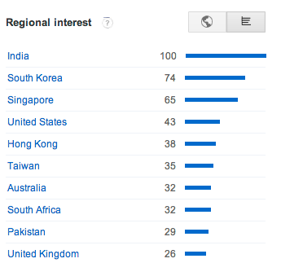
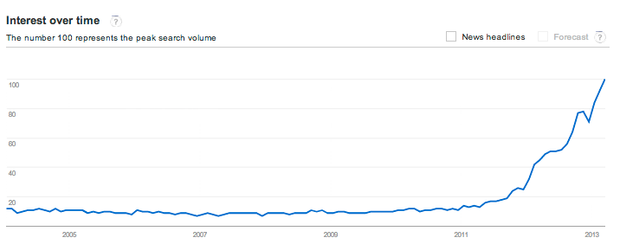
What is the big deal
Dec 2011
Dec 2012
http://www.google.com/trends/explore#q=big%20data

Slide 5
Some of the difficulties
Size of the data
2.5 quintillion of bytes is created daily
Wal-mart: 1,000,000 transaction an hour
Natural language processing
NOK means:
NOrwegian Korona
next-of-kin
nagie oko protein

Slide 6
Big Data on TV : 2011

Slide 7
… learn how to play on TV !
Category: Lincoln Blogs
Clue: Secretary Chase just submitted this to me for the third time; guess what, pal. This time I’m accepting it.
Answer:
his resignation
6 year old’s answer:
Friend Request

Slide 8
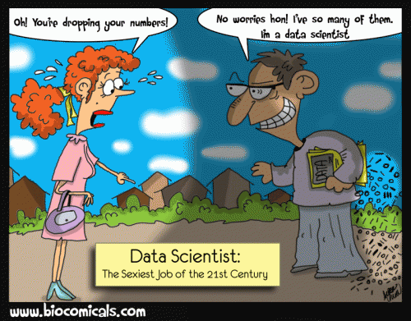
Harvard
Business
Review
Oct. 2012

Slide 9
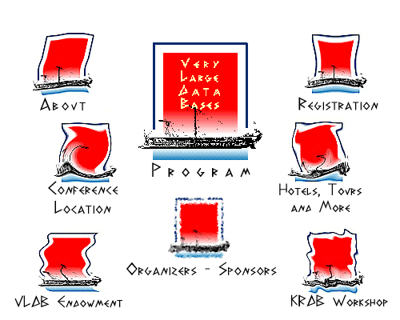
My first encounter: VLDB’97

Slide 10
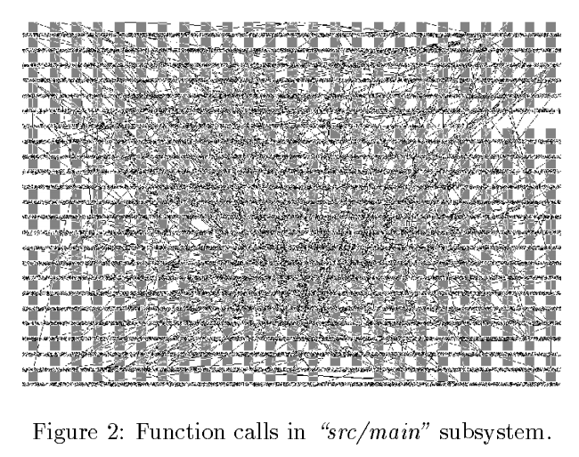
My second encounter: Apache’98

Slide 11
A definition of big data
“There are as many definitions as there are job postings about big data and data scientists” ☺
By 2018 there will be ~150,000 opening for jobs requiring analytical skills

Slide 12
Big data characteristics
Volume: amount of data generated by a 1 Gpx camera is 6 PB
Variety: Network connect healthcare devices
Velocity: >150,000 api requests per second to Google, Facebook and Twitter
Value: speed with which Business Intelligence can be acquired.

Slide 13
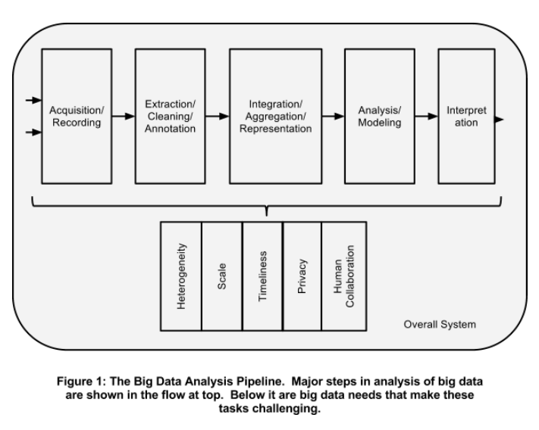
Architecture of a System

Slide 14
Courtesy: J.Freire, NYU

Slide 15
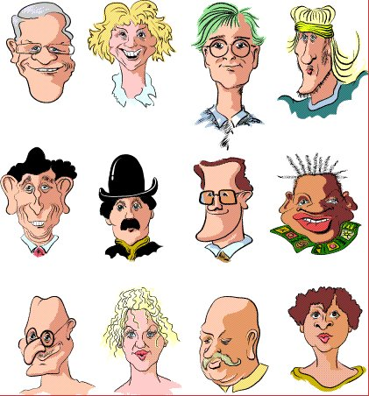
Exercise

Slide 16
Challenge: Nature of Data (1)
How do we place these movies in two groups ?
movie
director
actor
genre
Godfather II
Scorcese
De Niro
Crime
Preserves Information for actor, genre
Two choices for director
Good Fellas
Coppola
De Niro
Crime
Vertigo
Hitchcock
J. Stewart
Thriller
N by NW
Hitchcock
C. Grant
Thriller
Two choices for director, actor, and genre
Bishop’s Wife
Koster
C. Grant
Comedy
Harvey
Koster
J. Stewart
Comedy

Slide 17
Challenge: Nature of Data (2)
Group rows (objects) in order to preserve as much information as possible about the attribute values
movie
director
actor
genre
Godfather II
Scorcese
De Niro
Crime
Three choices for director, actor, and two for genre
Good Fellas
Coppola
De Niro
Crime
Vertigo
Hitchcock
J. Stewart
Thriller
N by NW
Hitchcock
C. Grant
Thriller
Preserves Information for director, genre
Two choices for actor
Bishop’s Wife
Koster
C. Grant
Comedy
Harvey
Koster
J. Stewart
Comedy

Slide 18
Importance of Good Results !

Slide 19
Embarked on Thoora.com

Slide 20
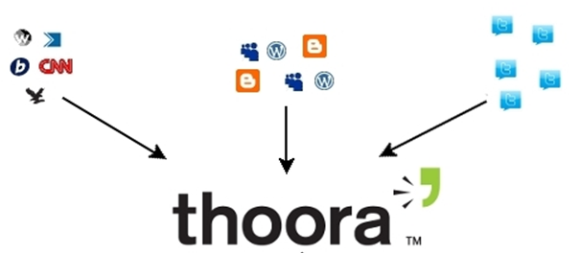
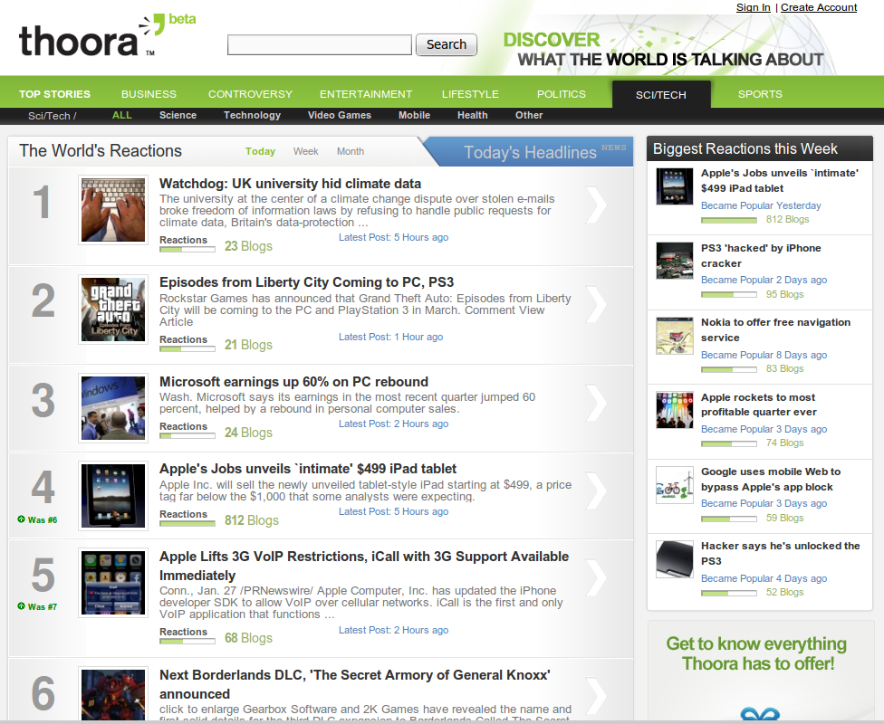
What is Thoora ?
Content analysis
Story integration
Story organization
High-tech online platform
Relevance
Thoora website (showcase)
Content analysis and publishing platform

Slide 21
Thoora website

Slide 22
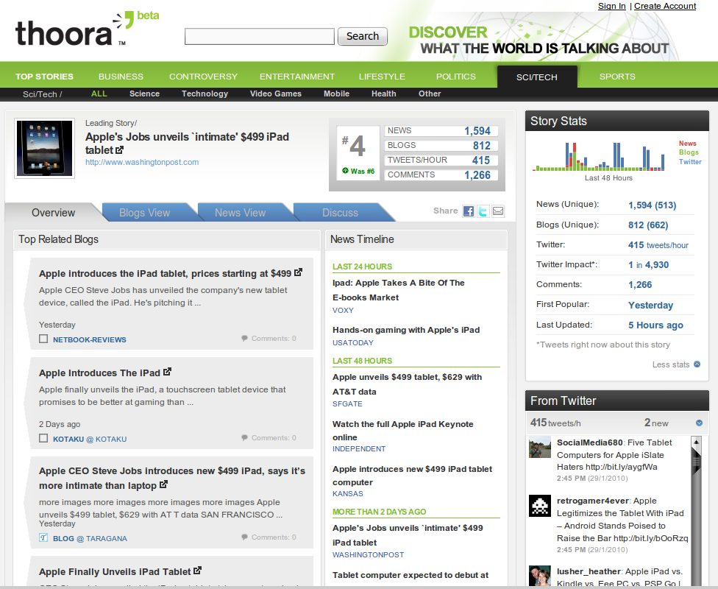
Thoora website

Slide 23
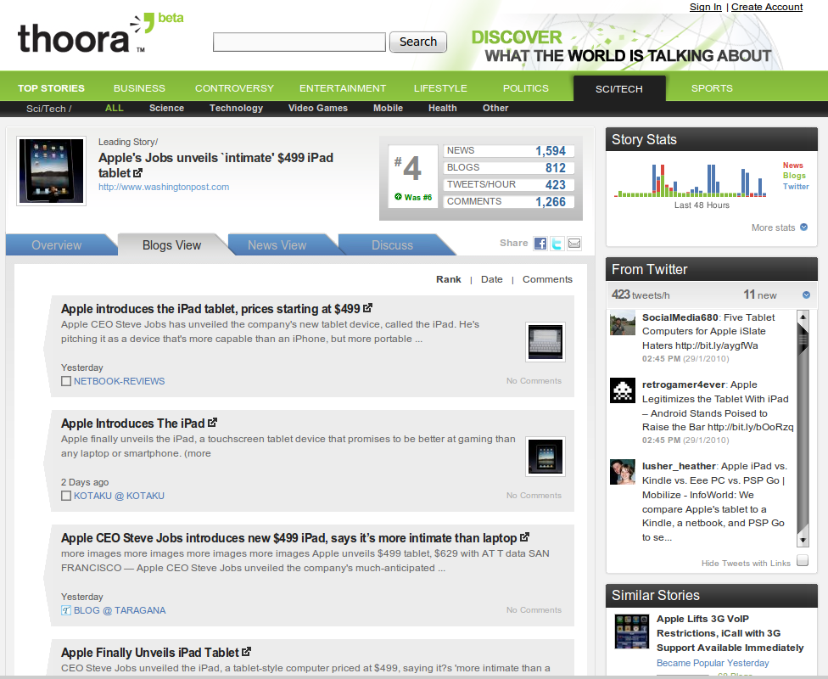
Thoora website

Slide 24
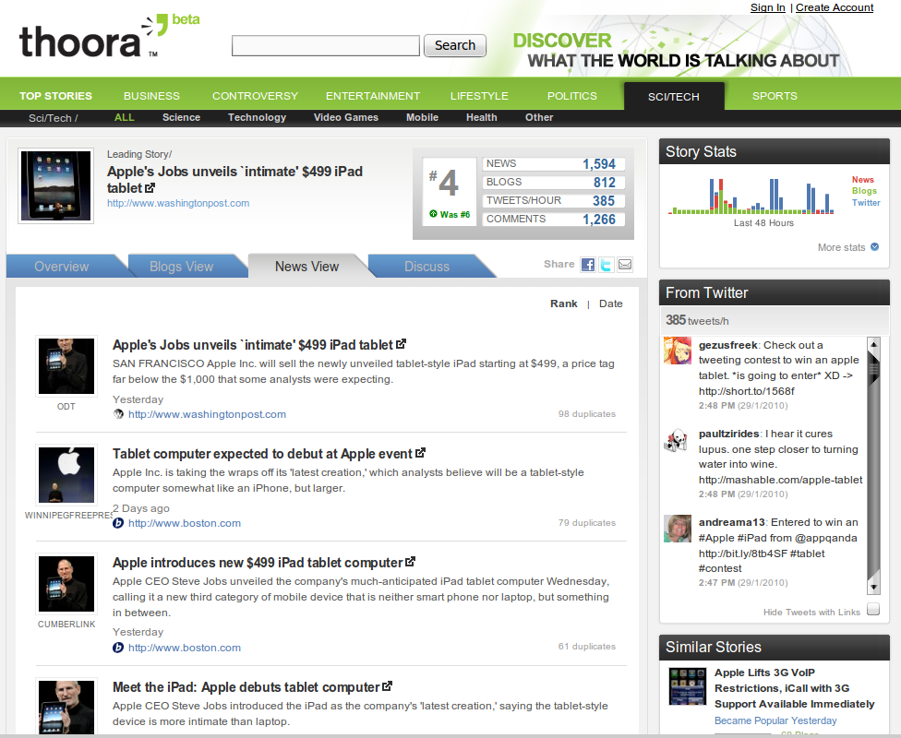
Thoora website

Slide 25
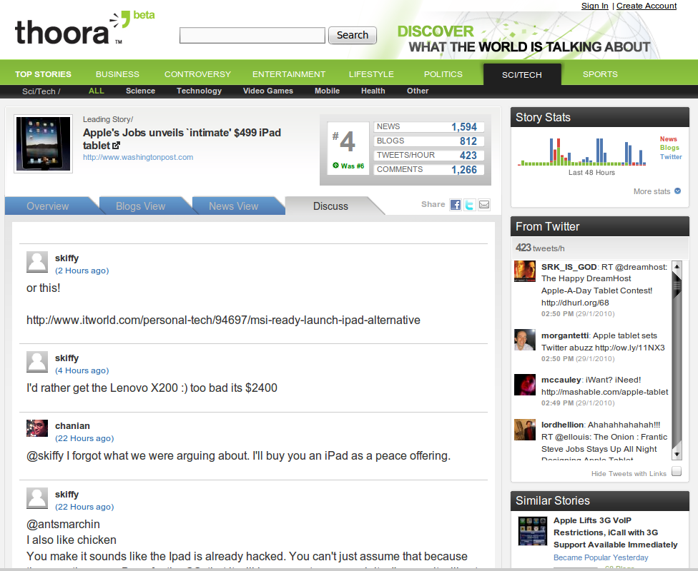
Thoora website

Slide 26
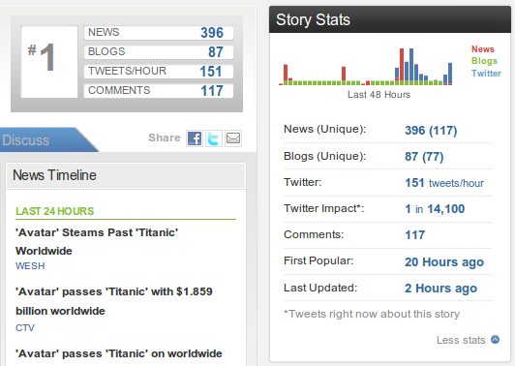
How do we do it ?
Acquire and process a large number of signals to extract meaningful indicators
What do the numbers tell us?
Large peak in news
Large peak in Twitter
81 Million Blogs
~52 Million tweets
~4,500 News sources
… Hundreds of signals

Slide 27
How do we do it ?
1st – Acquire and process a large number of signals to extract meaningful indicators
Important developments
History of the story
Dynamic and driven
by story evolution

Slide 28
How do we do it ?
Hotness
Predict trends
Measure ‘buzz’
Real time reaction

Slide 29
Impact
… unresolved issue
How to give journalists, editors, and publishers editorial influence over the content users access on the Internet?

Slide 30
Is there information in keywords ?
Given a set of clusters :
See what keywords describe them best
Identify temporal characteristics of keywords
Provide the user with keywords that increases traffic + revenue (S.E.M.)

Slide 31
Value of Keywords
Many ways :
tf, tf_idf
Information it carries about the cluster
Without knowledge of clusters, best guess about a keyword is its probability in corpus : p(Ki)*p(Ki)
With knowledge of clusters, the guess about a keyword is : p(Ki|c)*p(Ki|c)

Slide 32
Value of keyword
Expected increase in the ability to predict whether a keyword Ki is in C
P(C)[P(Ki|C)² – P(Ki)²] +
+(1-P(C))*[P(Ki)²-P(Ki|C)²]
Leads to info-theoretic measure + intuition

Slide 33
Some experiments
Frequency-based | Keyword Utility-based
fox | fox
megan | megan
transform | transform
‘s | movi
michael | paramount
bay | michael
shia | shia
love | film
drop | quit
paramount | drop

Slide 34
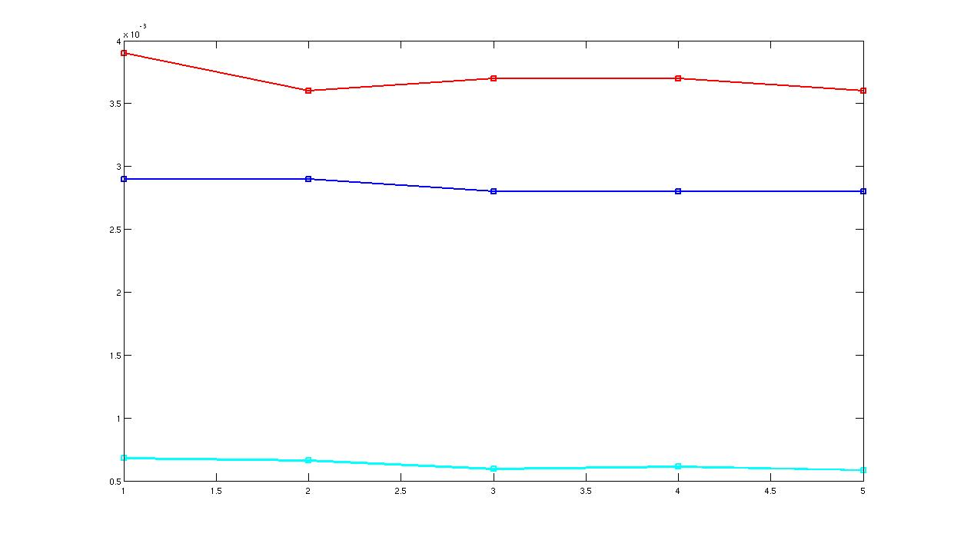
Story Evolution (1)
lohan
lindsay
actress

Slide 35
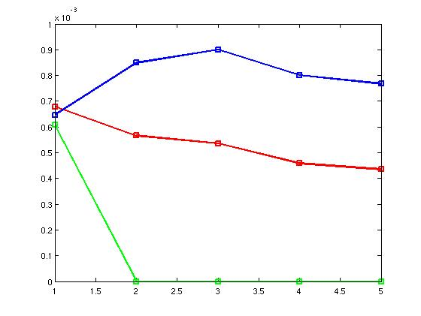
Story Evolution (2)
thursday
arrest
mandatory

Slide 36
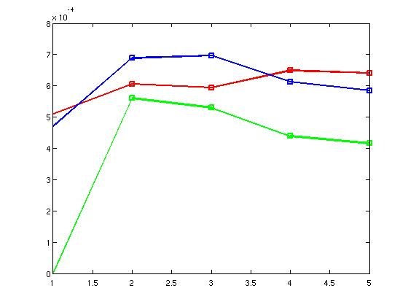
Story Evolution (3)
court
warrant
judge

Slide 37
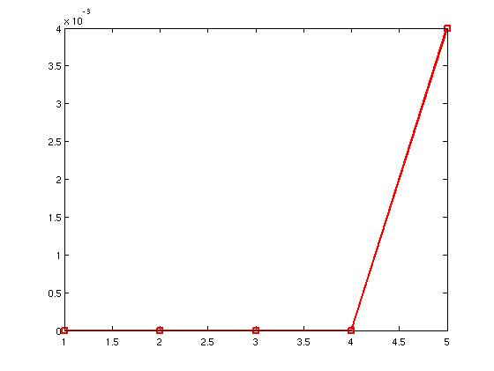
Story Evolution (4)
lifted

Slide 38
A small problem in the sea of Big Data
Title: Entity Resolution in Scopus.com
Crawling and semi-automatic extraction of citation information
Very well respected by UofT and other institutions
Important bibliometric indexes are calculated, e.g., the h-index

Slide 39
Press daemons in action !
Scopus
Google Scholar
Scopus h-index : 4
Scholar h-index: 13 !!!!!

Slide 40
Manual inspection
For each Scholar paper, manually checked every paper and if it existed in Scopus but not counted, messaged them !
Approximate total time: 50 hours
Problems found: 133 citations not counted
Papers affected: 7/14 index in my profile
Prepared a document worth 45 pages ☺

Slide 41
Example errors !
Publishers submit the wrong data
Cannot do much about it !
Typographical
Andristsos vs. Andritsos
Lost one paper that Google Scholar has “fixed”
Automatic approaches do not assess proximity correctly

Slide 42
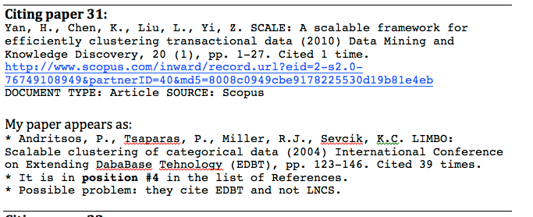
Example errors ! (cont.)

Slide 43
So what is my connection with Big Data ?
Automatic techniques for unsupervised techniques, e.g. clustering
Why rely on others’ perception of what is what ?
Work/Worked on textual/categorical data
Do you know how far is Scorsese from Coppola ?
Answer questions like “Can we predict the future”
Looking at twitter stories, tell how they’ll evolve

Slide 44
So what is my connection with Big Data ?
How do we visualize concept evolution ?
How do we visualize associations ?
How do we bring data closer to the user ?

Slide 45
