Slide 1
Tutorial Meeting #2
Data Science and Machine Learning
Map-Reduce and the New Software Stack
Περικλής Ανδρίτσος

Slide 2
Introduction
Once upon a time….
There used to be just a single computer
It used to perform calculations all by itself
Later in the years to come….
Data sources started proliferating
Size of the data sources that are used in calculations exploded
Advanced programming techniques started to appear
That’s when advanced science came in and gave us “distributed computation”
MapReduce is a representative of such technology

Slide 3
MapReduce (section 2)
Challenges:
How to distribute computation?
Distributed/parallel programming is hard
Map-reduce addresses all of the above
Google’s computational/data manipulation model
Elegant way to work with big data

Slide 4
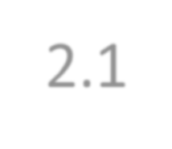
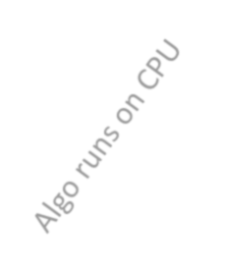
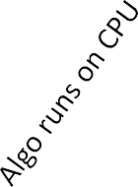
Single Node Architecture (section 2.1)
{
CPU
Machine Learning, Statistics
Memory
“Classical” Data Mining
Disk
Main needs:
a storage infrastructure and a programming paradigm (for analysis)

Slide 5
Motivation: Google Example
20+ billion web pages x 20KB = 400+ TB
1 computer reads 30-35 MB/sec from disk
~4 months to read the web
~1,000 hard drives to store the web
Takes even more to do something useful
with the data, both in terms of storing it as well as the time needed
to analyze it !!
Today, a standard architecture for such problems is emerging:
Cluster of commodity Linux nodes
Commodity network (ethernet) to connect them

Slide 6
Big picture of the new paradigm
Split the data into chunks
Have multiple disks and CPUs
Distribute the data chunks across multiple disks
Process the data in parallel across CPUs
Example:
Time to read data: 4million secs (46+ days)
If we had 1000 CPUs we can do the task in
4 million / 1000 = 4000 seconds (about 1 hour)

Slide 7
Cluster Architecture (Section 2.1.1)
2-10 Gbps backbone between racks
Switch
1 Gbps between
any pair of nodes
Each rack contains 16-64 nodes
in a rack
Switch
Switch
Disk
Disk
Disk
Disk
CPU
CPU
CPU
CPU
Mem
…
Mem
Mem
…
Mem
It has been estimated that Google has 1M machines, http://bit.ly/Shh0RO

Slide 8
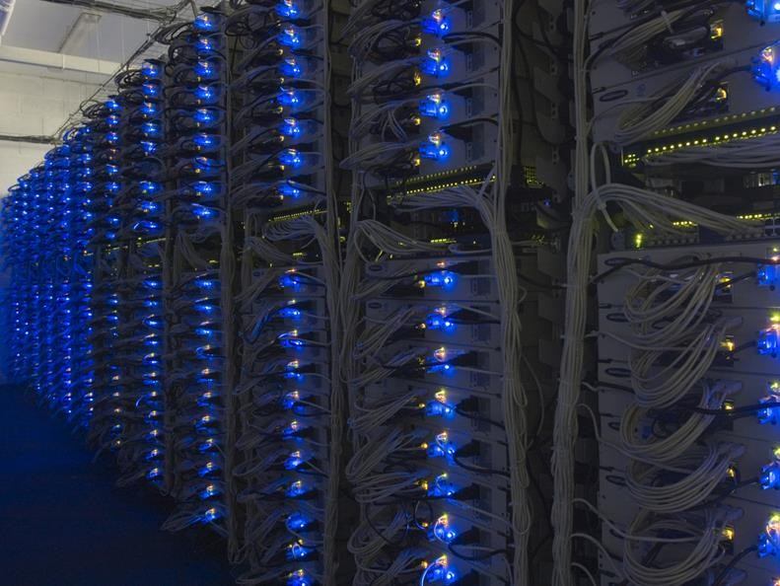

Slide 9
Large-scale Computing
Large-scale computing for data mining
problems on commodity hardware
Challenges:
How do you distribute computation?
How can we make it easy to write distributed programs?
Machines fail:
One server may stay up 3 years (1,000 days)
If you have 1,000 servers, expect to lose 1/day
If Google has ~1M machines, then
1,000 machines fail every day!

Slide 10
Large-scale Computing (2)
Problem #1: If nodes fail at such a rate, how do we make sure data is
stored PERSISTENTLY
i.e., we are guaranteed to have data (or its copies) if machines that store it fail.
What if nodes fail during a long-running process what do we do ?
E.g., do we restart the process all over again ?
Solution: a new infrastructure that ”hides” all these failures

Slide 11
Large-scale Computing (3)
Problem #2: Network Bottleneck
If bandwidth = 1 Gbps, moving 10TB takes ~1 day
In typical applications data moves around to be analyzed
In our case we should be moving enormous amounts of data into thousands of servers and that can be prohibitive
Solution: a new framework that doesn’t move data around !
In my opinion: the big beauty of MapReduce !!

Slide 12
Map-Reduce (Section 2.2)
It addresses previously mentioned problems in the following ways:
Stores data redundantly on multiple nodes (computers) for persistence and availability
Move computation close to the data to minimize data movement. This is a
simple yet powerful idea.
Simple programming model that even non-savvy programmers can implement

Slide 13
Idea and Solution
Issue: Copying data over a network takes time
Idea:
Bring computation close to the data
Store files multiple times for reliability
Map-reduce addresses these problems
Google’s computational/data manipulation model
Elegant way to work with big data
Storage Infrastructure – File system
Google: GFS. Hadoop: HDFS
Programming model
Map-Reduce

Slide 14
Storage Infrastructure
Problem:
If nodes fail, how to store data persistently?
Answer:
Distributed File System (redundant storage):
Provides global file namespace
Implementations: Google GFS; Hadoop HDFS;
Stores each data piece multiple times across servers
Typical usage pattern
Huge files (100s of GB to TB)
Data is rarely updated in place (e.g. storing URLs)
Reads and appends are common

Slide 15
Distributed File System
Reliable distributed file system
Data kept in “chunks” spread across machines
Each chunk replicated on different machines
Seamless recovery from disk or machine failure
C₀
C₁
D₀
C₁
C₂
C₅
C₀
C₅
…
C₅
C₂
C₅
C₃
D₀
D₁
D₀
C₂
Chunk server 1 Chunk server 2 Chunk server 3 Chunk server N
Bring computation directly to the data!
Chunk servers also serve as compute servers

Slide 16
Distributed File System
Chunk servers
File is split into contiguous chunks
Typically each chunk is 16-64MB
Each chunk replicated (usually 2x or 3x)
Try to keep replicas in different racks
Master node
a.k.a. Name Node in Hadoop’s HDFS
Stores information about where files are stored
Might be replicated
Client library for file access
Talks to master to find chunk servers
Connects directly to chunk servers to access data

Slide 17
Coordination: Master
Master node takes care of coordination:
Task status: (idle, in-progress, completed)
Idle tasks get scheduled as workers become available
When a map task completes, it sends the master the location and sizes of its
R intermediate files, one for each reducer
Master pushes this info to reducers
Master pings workers periodically to detect failures

Slide 18
Dealing with Failures
Map worker failure
Map tasks completed or in-progress at
worker are reset to idle
Reduce workers are notified when task is rescheduled on another worker
Reduce worker failure
Only in-progress tasks are reset to idle
Reduce task is restarted
Master failure
MapReduce task is aborted and client is notified

Slide 19
Fault tolerance:
Handled via re-execution
On worker failure:
Detect failure via periodic heartbeats
Re-execute completed and in-progress map tasks
Task completion committed through master
Robust: Google lost 1600 of 1800 machines, but kept running fine

Slide 20
Programming Model: MapReduce
Warm-up task:
We have a huge text document
Maybe 10-20TB of size
Count the number of times each
distinct word appears in the file
Sample application:
Analyze web server logs to find popular URLs
Keyword statistic for search

Slide 21
Task: Word Count
Case 1:
File too large for memory, but all <word, count> pairs fit in memory <-
simple program !
Case 2:
Count occurrences of words:
words(doc.txt) | sort | uniq -c
where words takes a file and outputs the words in it, one per a line
Case 2 captures the essence of MapReduce
Great thing is that it is naturally parallelizable

Slide 22
MapReduce: Overview
words(doc.txt) | sort
Map
Scan input file one record at a time
Extract something you care about from each record (keys)
Group by key
Groups all the keys with the same value
Sort and shuffle
Reduce
Run a function
Aggregate, summarize, filter or transform
Write the answer

Slide 23
MapReduce: The Map Step
Input
key-value pairs
Intermediate key-value pairs
k v
k v
k v
map
k
v
v
map
k
…
…
k
v
k
v

Slide 24
MapReduce: The Reduce Step
Output
key-value pairs
k v
k v
Intermediate key-value pairs
k v
k v
k v
Key-value groups
k v v
k v v
reduce
v
Group by key
reduce
…
…
…
k
v
k
v
k
v

Slide 25
More Specifically
Input: a set of key-value pairs
Programmer specifies two methods:
Map(k, v) → <k’, v’>*
Takes a key-value pair and outputs a set of key-value pairs
E.g., key is the filename, value is a single line in the file
There is one Map call for every (k,v) pair
Reduce(k’, <v’>*) → <k’, v’’>*
All values v’ with same key k’ are reduced together and processed in v’ order
There is one Reduce function call per unique key k’
Note: * means a set

Slide 26
Map-Reduce: Environment
Map-Reduce environment takes care of:
Partitioning the input data
Scheduling the program’s execution across a set of machines
Performing the group by key step
Handling machine failures
Managing required inter-machine communication

Slide 27
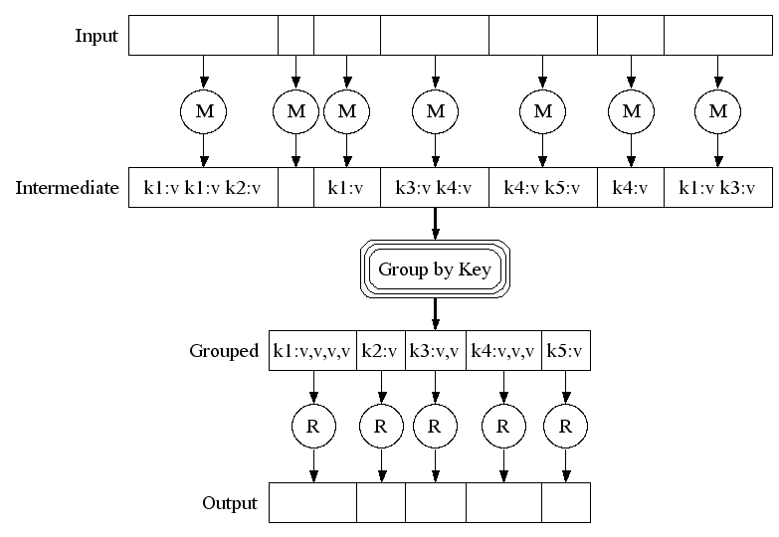
Map-Reduce: A diagram (centralized)
Big document
MAP:
Read input and produces a set of key-value pairs
Group by key:
Collect all pairs with same key
(Hash merge, Shuffle,
Sort, Partition)
Map function
Reduce:
Collect all values belonging to the key and output
Reduce function
28

Slide 28
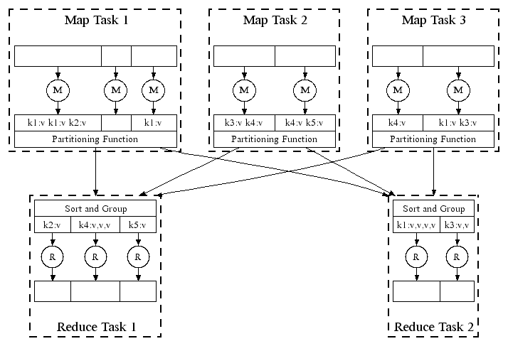
Map-Reduce: In Parallel
Node
Ensures all list with same
key are sent to the same reduce node
All phases are distributed with many tasks doing the work
29

Slide 29
Map-Reduce
Programmer specifies:
Map and Reduce and input files
Workflow:
Read inputs as a set of key-value-pairs
Map transforms input kv-pairs into a new set of k'v'-pairs
Sorts & Shuffles the k'v'-pairs to output nodes
All k’v’-pairs with a given k’ are sent to the
same reduce
Reduce processes all k'v'-pairs grouped by key into new k''v''-pairs
Write the resulting pairs to files
Input 0
Input 1
Input 2
Map 0
Map 1
Map 2
Shuffle
Reduce 0
Reduce 1
All phases are distributed with many tasks
doing the work
Out 0
Out 1

Slide 30
Data Flow
Input and final output are stored on a distributed file system (FS):
Scheduler tries to schedule map tasks “close” to physical storage location of
input data
Intermediate results are stored on local FS of Map and Reduce workers
Output is often input to another MapReduce task

Slide 31
MapReduce: Word Counting
Provided by the
Provided by the programmer
Key appears programmer
1 time
MAP:
Read input and produces a set of key-value pairs
Group by key:
Collect all pairs with same key
Reduce:
Collect all values belonging to the key and output
Big document
The crew of the space shuttle Endeavor recently returned to Earth as
ambassadors, harbingers of a new era of space exploration. Scientists at NASA are saying that the
recent assembly of the Dextre bot is the first step in a long-term space-based
man/mache partnership. '"The work we're doing now -- the robotics we're doing - - is what we're going to need ……………………..
(The, 1) (crew, 1)
(of, 1) (the, 1)
(space, 1) (shuttle, 1)
(Endeavor, 1) (recently, 1) ….
(crew, 1) (crew, 1) (space, 1)
(the, 1) (the, 1) (the, 1)
(shuttle, 1) (recently, 1) …
(crew, 2)
(space, 1)
(the, 3)
(shuttle, 1)
(recently, 1)
…
OSnelqyuesnetiqaulleynrteiald threeadasta
(key, value)
(key, value)
(key, value)

Slide 32
Word Count Using MapReduce
map(key, value):
// key: document name; value: text of the document for each word w in value:
emit(w, 1)
reduce(key, values):
// key: a word; values: an iterator over counts result = 0
for each count v in values: result += v
emit(key, result)

Slide 33
Refinement: Partition Function
Want to control how keys get partitioned
Inputs to map tasks are created by contiguous splits of input file
Reduce needs to ensure that records with the same intermediate key end up at the same worker
System uses a default partition function:
hash(key) mod R
Sometimes useful to override the hash function:
E.g., hash(hostname(URL)) mod R ensures URLs from a host end up in the same output file

Slide 34
Selection by Map-Reduce
Given a table R compute the operation 𝜎_{𝑐𝑜𝑛𝑑𝑖𝑡𝑖𝑜𝑛} 𝑅 , where condition is a logical expression. Selection chooses the tuples from R that satisfy the condition.
Alternatively, in SQL, the operation is
SELECT attributes
FROM R
WHERE “condition is true”
𝑹
A | B
ª1: | b₁
a₂ | b₁
a₃ | b₂
a₄ | b₃
𝜎_{𝐵=𝑏} (𝑅)
A | B
ª1: | b₁
a₂ | b₁
1

Slide 35
Selection by Map-Reduce
Mapper
Emit only tuples that satisfy the selection condition
The (key,value) pairs are of the form (t,t), where t is a tuples satisfying the condition.
In the previous example
((a1,b1),(a1,b1))
((a2,b1),(a2,b1))
Reducer
No reducer is required

Slide 36
GROUP BY and AGGREGATION by Map-Reduce
Compute the query, Q: SELECT A,B,SUM(C)
FROM R
GROUP BY A,B
R(A,B,C) is stored in a file
A | B | C
A₁ | b₁ | 1
A₁ | b₁ | 2
A₃ | b₂ | 3
A₃ | b₂ | 4
𝛾
(R)
A | B | C
A₁ | b₁ | 3
A₃ | b₂ | 7
Α, B, SUM(C)
R

Slide 37
GROUP BY and AGGREGATION by Map-Reduce
Mapper
The (Key, Value) pairs are of the form:
Key =<attributes in GROUP BY>
Value =<attributes in AGGREGATION.
In the previous example
((A1,B1),1)
((A1,B1),2)
((A3,B2),3)
((A3,B2),4)
Reducer
Applies the aggregation operation on the list of values and outputs results
In the previous example
(A1,B1,3)
(A3,B2,7)

Slide 38
Natural Join By Map-Reduce
Compute the natural join R(A,B) ⋈ S(B,C)
R and S are each stored in files
Tuples are pairs (a,b) or (b,c)
A | B
a₁ | b₁
a₂ | b₁
a₃ | b₂
a₄ | b₃
B | C
b₂ | c₁
b₂ | c₂
b₃ | c₃
A | B | C
a₃ | b₂ | c₁
a₃ | b₂ | c₂
a₄ | b₃ | c₃
⋈
R⋈S
=
S
R

Slide 39
Map-Reduce Join
Use a hash function h from B-values to 1...k
A Map process turns:
Each input tuple R(a,b) into key-value pair (b,(a,R))
Each input tuple S(b,c) into (b,(c,S))
Map processes send each key-value pair with key b to Reduce process h(b)
Hadoop does this automatically; just tell it what k is.
Each Reduce process matches all the pairs (b,(a,R)) with all (b,(c,S)) and outputs (a,b,c).

Slide 40
Matrix-Vector Multiplication with Map/Reduce
A 2
B 0
C
20
1
0
0
3 4
X
=
110
5 0 6
20
120
Task: Compute product C = A·B

Slide 41
Computing Sparse Matrix-Vector Product
A 2
〈1, 1, 1, A〉
0 〈1, 2, 2, A〉
〈2, 2, 3, A〉
〈2, 3, 4, A〉
〈3, 1, 5, A〉
〈3, 3, 6, A〉
B
1
0
〈2, 1, 10, B〉
〈3, 1, 20, B〉
0
3 4
X
5 0 6
20
Represent matrix as list of nonzero entries 〈row, col, value, matrixID〉
Strategy
Phase 1: Compute all products a_{i,k} · b_{k,j}
Phase 2: Sum products for each entry i,j
Each phase involves a Map/Reduce

Slide 42
Group by - Map of Matrix-Vector Multiply
Mapping of Initial representation to intermediate keys
Group By Intermediate Keys
Key = 1
(1, (A, 1, 1))
(1, (A, 3, 5))
〈row, col, value, matrixID〉→ (col, (matrixID, row, value))
A 2
〈1, 1, 1, A〉→ (1, (A, 1, 1))
〈1, 2, 2, A〉→ (2, (A, 1, 2))
〈2, 2, 3, A〉→ (2, (A, 2, 3))
〈2, 3, 4, A〉→ (3, (A, 2, 4))
〈3, 1, 5, A〉→ (1, (A, 3, 5))
〈3, 3, 6, A〉→ (3, (A, 3, 6))
Key = col
1
0
Key = 2
0
3 4
(2, (A, 1, 2))
(2, (A, 2, 3))
(2, (B, 1, 10))
5 0 6
B 0
Key = 3
(3, (A, 2, 4))
(3, (A, 3, 6))
(3, (B, 1, 20))
〈2, 1, 10, B〉→ (2, (B, 1, 10))
〈3, 1, 20, B〉→ (3, (B, 1, 20))
Key = row
20
Group values a_{i,k} and b_{k,j} according to key k

Slide 43
Group by - Reduce of Matrix-Vector Multiply
Key = 1
(1, (A, 1, 1))
X
(1, (A, 3, 5))
A
2
B 0
1
0
Key = 2
_{(2, (A, 2, 3))} X (2, (B, 1, 10))
(2, (A, 1, 2))
〈1, 1, 2x10=20, C〉
〈2, 1, 3x10=30, C〉
0
3 4
X
5 0 6
20
Key = 3
(3, (A, 2, 4))
〈2, 1, 4x20=80, C〉
〈3, 1, 6x20=120, C〉
X
(3, (B, 1, 20))
(3, (A, 3, 6))
Generate all products a_{i,k} · b_{k,j}

Slide 44
Aggregate - Map of Matrix-Vector Multiply
Mapping of intermediate representation to intermediate keys
〈row, col, value, matrixID〉→ ((row, col), (matrixID, value))
〈1, 1, 20, C〉→ ((1, 1), (C, 20))
〈2, 1, 30, C〉→ ((2, 1), (C, 30))
〈2, 1, 80, C〉→ ((2, 1), (C, 80))
〈3, 1, 120, C〉→ ((3, 1), (C, 120))
Key = (row,col)
Key = 1,1
((1, 1), (C, 20))
((2, 1), (C, 30))
((2, 1), (C, 80))
Key = 2,1
Key = 3,1
((3, 1), (C, 120))
A
2
B 0
1
0
0
3 4
X
5 0 6
20
Group products a_{i,k} · b_{k,j} with matching values of i and j

Slide 45
Aggregate - Reduce of Matrix-Vector Multiply
Key = 1,1 ((1, 1), (C, 20)) +
C
〈1, 1, 20, C〉
〈2, 1, 110, C〉
〈3, 1, 120, C〉
20
Key = 2,1
((2, 1), (C, 30))
((2, 1), (C, 80))
+
110
Key = 3,1 ((3, 1), (C, 120))+
120
A
2
B 0
1
0
0
3 4
X
5 0 6
20
Sum products to get final entries

Slide 46
Cost Measures for Algorithms
In MapReduce we quantify the cost of an algorithm using
Communication cost = total I/O of all processes
Computation cost analogous, but count only running time of processes
Note that here the big-O notation is not the most useful (adding more machines is always an option)

Slide 47
Example: Hosting size
Suppose we have a large web corpus
Look at the metadata file
Lines of the form: (URL, size, date, …)
For each host, find the total number of bytes
That is, the sum of the page sizes for all URLs from that particular host
Map
For each record, output (hostname(URL), size)
Reduce
Sum up the sizes of each host

Slide 48
Example: Language Model
Statistical machine translation:
Need to count number of times every 5-word sequence occurs in a large
corpus of documents
Very easy with MapReduce:
Map:
Extract (5-word sequence, count) from document
Reduce:
Combine the counts

