Slide 1
Recommendation Systems
(Chapter 9 of MMDS book
& Chapter 9 of the SMM book)

Slide 2
Content
Methods and Algorithms
  Content-based RSs
  Collaborative Filtering
    User-based
    Item-based
Evaluation methods
  MAE, RMSE
  Precision, Recall, ROC, nDCG
  Beyond Accuracy Metrics
    Novelty, Diversity, Explainability

Slide 3
Recommendation vs. Search
One way to get answers is using search engines
Search engines find results that match the query provided by the user
The results are generally provided as a list ordered with respect to the relevance of the item to the given query
Consider the query “best 2014 movie to watch”
  The same results for an 8 year old and an adult
Search engines’ results are not customized

Slide 4
Content-based Recommendation Algorithm
Describe the items to be recommended
Create a profile of the user that describes the types of items the user likes
Compare items with the user profile to determine what to recommend
The profile is often created, and updated automatically in response to feedback on the desirability of items that are presented to the user

Slide 5
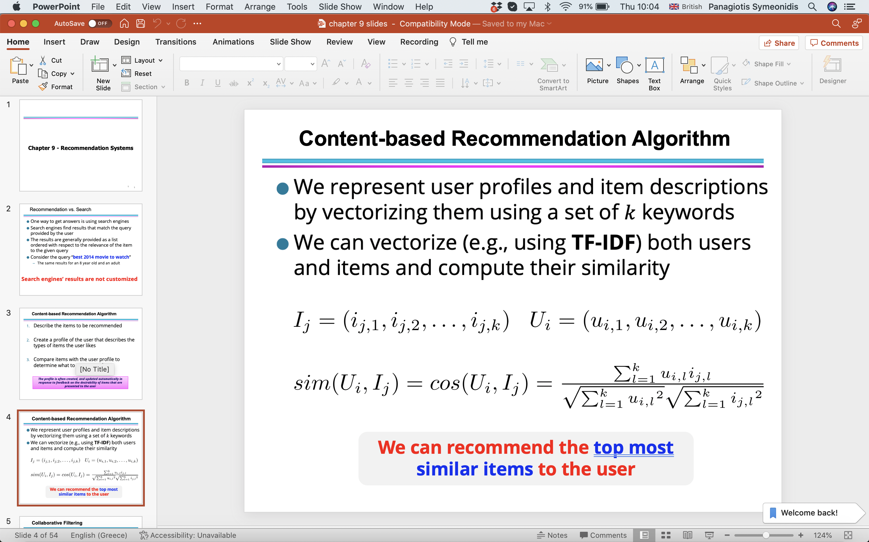
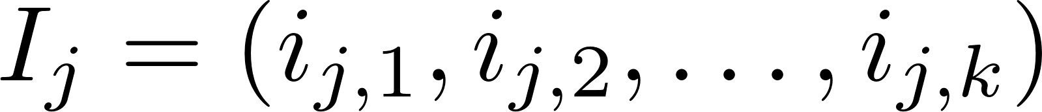
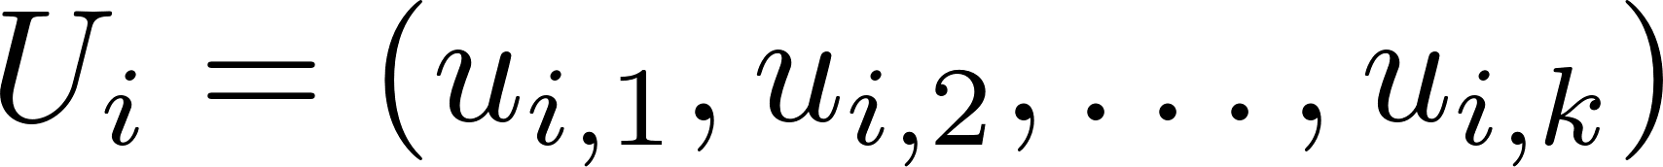
Content-based Recommendation Algorithm
We can recommend the top most similar items to the user

Slide 6
Collaborative Filtering
The process of selecting information or patterns using techniques involving collaboration among multiple users
Advantages:
We don’t need to have additional information about the users or content of the items
  Users’ rating or purchase history is the only information that is needed to work
Users do not take item recommendations similar to their previous interactions
  more novel recommendations

Slide 7
Collaborative Filtering
Two types of entities: Users and Items
A background knowledge:
  A set of ratings in the rating scale [0,ub] (ub … upper bound) is the mapping function r
    r: Users x Items → R {?} (utility matrix)
A method for eliminating all or part of the ‘?’ values - for some (user, item) pairs – with predicted values
A method for selecting the items to recommend
  Recommend to u the item i*=arg max_{i∈Items} {r*(u,i)}
r*(u, i) = Average {r(su, i)} _{su similar to u}
Notes:
fino a qui

Slide 8
Collaborative Filtering - Algorithm
Weight all users/items with respect to their similarity with the current user/item
Select a subset of the users/items (neighbors) as recommenders
Predict the rating of the user for specific items using neighbors’ ratings for the same (or similar) items
Recommend items with the highest predicted rating

Slide 9
Collaborative Filtering
User-based CF
Users with similar previous ratings for items are likely to rate future items similarly
Item-based CF
Items that have received similar ratings previously from users are likely to receive similar ratings from future users

Slide 10
User-based collaborative filtering (1)
The basic technique:
  Given an ”target user" (Alice) and an item I not yet seen by Alice
  The goal is to estimate Alice's rating for this item, e.g., by
    find a set of users (peers) who liked the same items as Alice in the past and who have rated item I
    use, e.g. the average of their ratings to predict, if Alice will like item I
    do this for all items Alice has not seen and recommend the best-rated
 | Item1 | Item2 | Item3 | Item4 | Item5
Alice | 5 | 3 | 4 | 4 | ?
User1 | 3 | 1 | 2 | 3 | 3
User2 | 4 | 3 | 4 | 3 | 5
User3 | 3 | 3 | 1 | 5 | 4
User4 | 1 | 5 | 5 | 2 | 1

Slide 11
User-based collaborative filtering (2)
Some first questions
  How do we measure similarity?
  How many neighbors should we consider?
  How do we generate a prediction from the neighbors' ratings?
 | Item1 | Item2 | Item3 | Item4 | Item5
Alice | 5 | 3 | 4 | 4 | ?
User1 | 3 | 1 | 2 | 3 | 3
User2 | 4 | 3 | 4 | 3 | 5
User3 | 3 | 3 | 1 | 5 | 4
User4 | 1 | 5 | 5 | 2 | 1

Slide 12

Measuring user similarity
A popular similarity measure in user-based CF: Pearson correlation
  a, b : users
  r_{a,p} : rating of user a for item p
  P : set of items, rated both by a and b
  Possible similarity values between -1 and 1;
 | Item1 | Item2 | Item3 | Item4 | Item5
Alice | 5 | 3 | 4 | 4 | ?
User1 | 3 | 1 | 2 | 3 | 3
User2 | 4 | 3 | 4 | 3 | 5
User3 | 3 | 3 | 1 | 5 | 4
User4 | 1 | 5 | 5 | 2 | 1
sim = 0,85
sim = 0,70
sim = -0,79

Slide 13
Pearson correlation
Takes differences in rating behavior into account
Works well in usual domains, compared with alternative measures
  such as cosine similarity

Slide 14
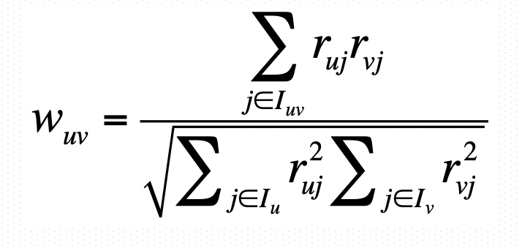
Proximity Measure: Cosine Similarity
Pearson Correlation can be replaced with a typical Information Retrieval (IR) similarity measure: cosine similarity

Slide 15
Comparison: Pearson vs. Cosine
Pearson
Cosine
User 2 ratings are those of user 1 incremented by 1
User 3 has “opposite” preferences of user 1
Notes:
With cosine user3 is closer to user2 than to user1
r_3i = 6 – r_1i

Slide 16

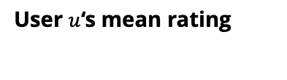
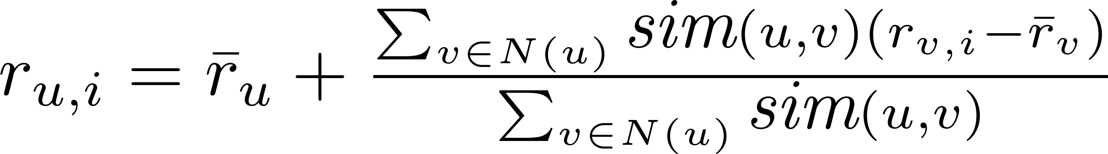
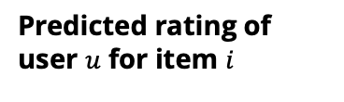
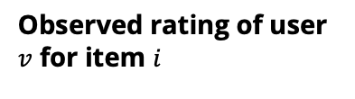
Making Rating Predictions
  Calculate, whether the neighbors' ratings for the unseen item i are higher or lower than their average
  Combine the rating differences – use the similarity with as a weight
  Add/subtract the neighbors' bias from the active user's average and use this as a prediction

Slide 17
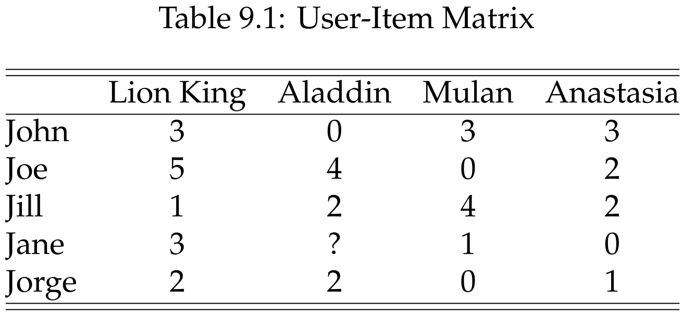
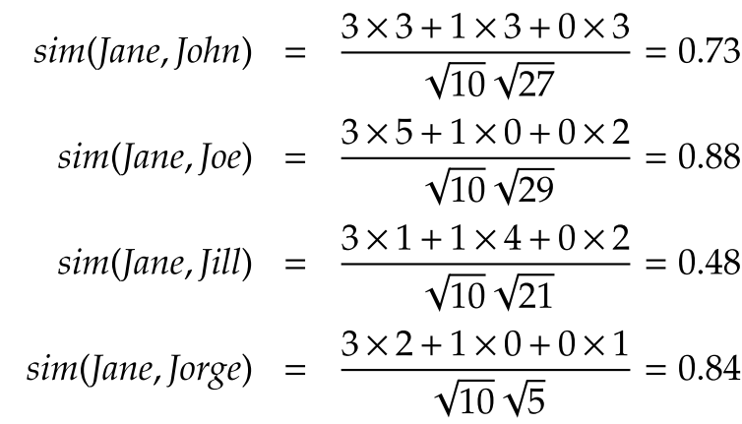
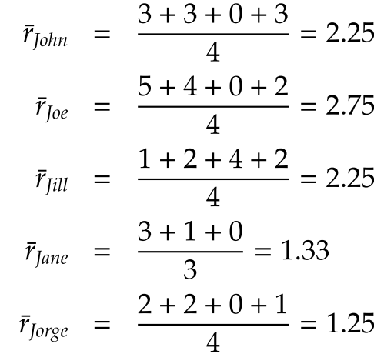
User-based CF (Similarity inference)
Predict Jane’s rating for Aladdin
1- Calculate average ratings
2- Calculate user-user similarity
Notes:
Predict Jane’s rating for Aladdin

Slide 18
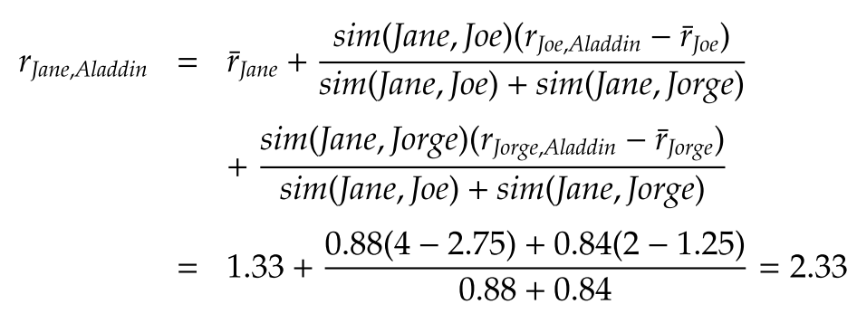
User-based CF (Rating Prediction)
3 - Calculate Jane’s rating for Aladdin,
Assume that neighborhood size = 2

Slide 19
Making recommendations
Making predictions is typically not the ultimate goal
Usual approach (in academia)
  Rank items based on their predicted ratings
However
  This might lead to the inclusion of (only) niche items
  In practice also: Take item popularity into account
Approaches
  "Learning to rank"
    Optimize according to a given rank evaluation metric (see later)

Slide 20
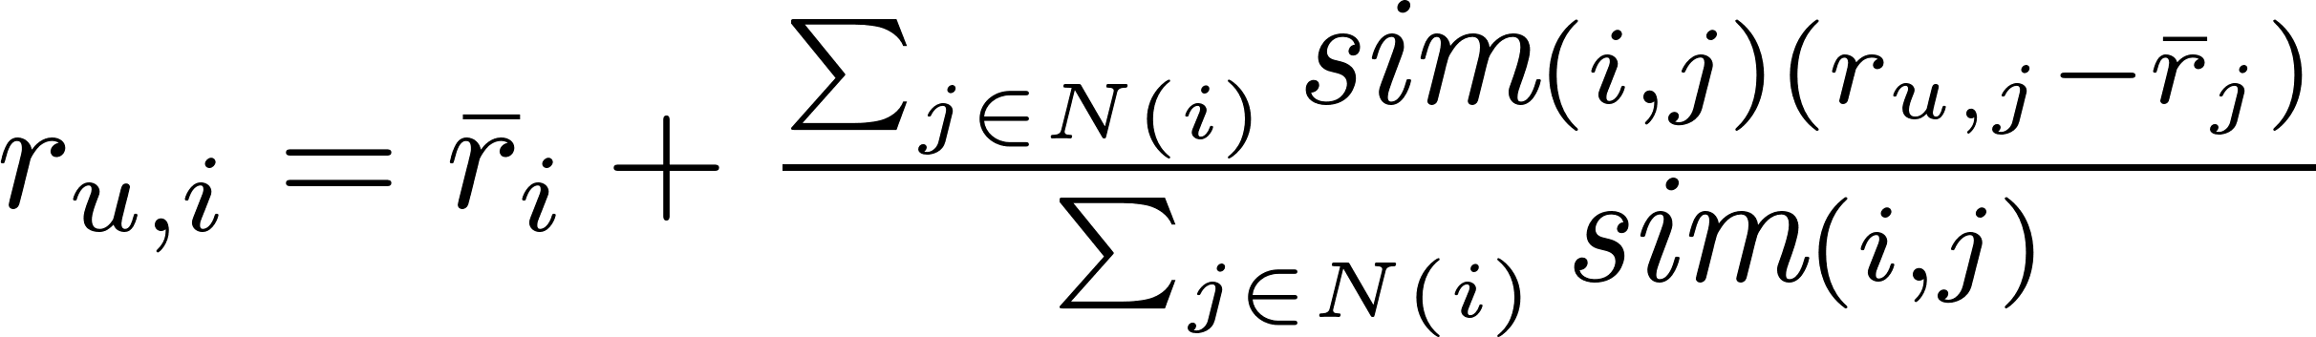


Item-based CF (Rating Prediction)
Calculate the similarity between items and then predict new items based on the past ratings for similar items

Slide 21
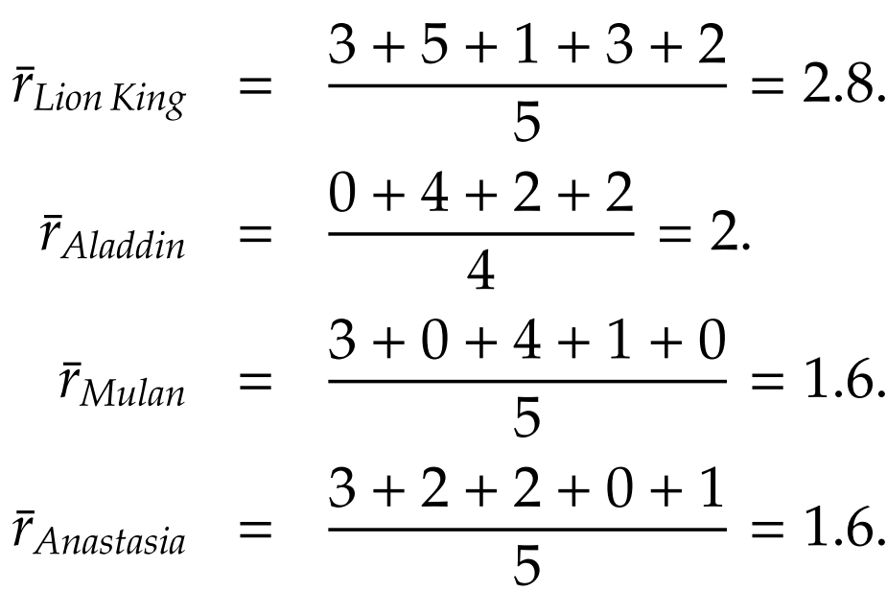
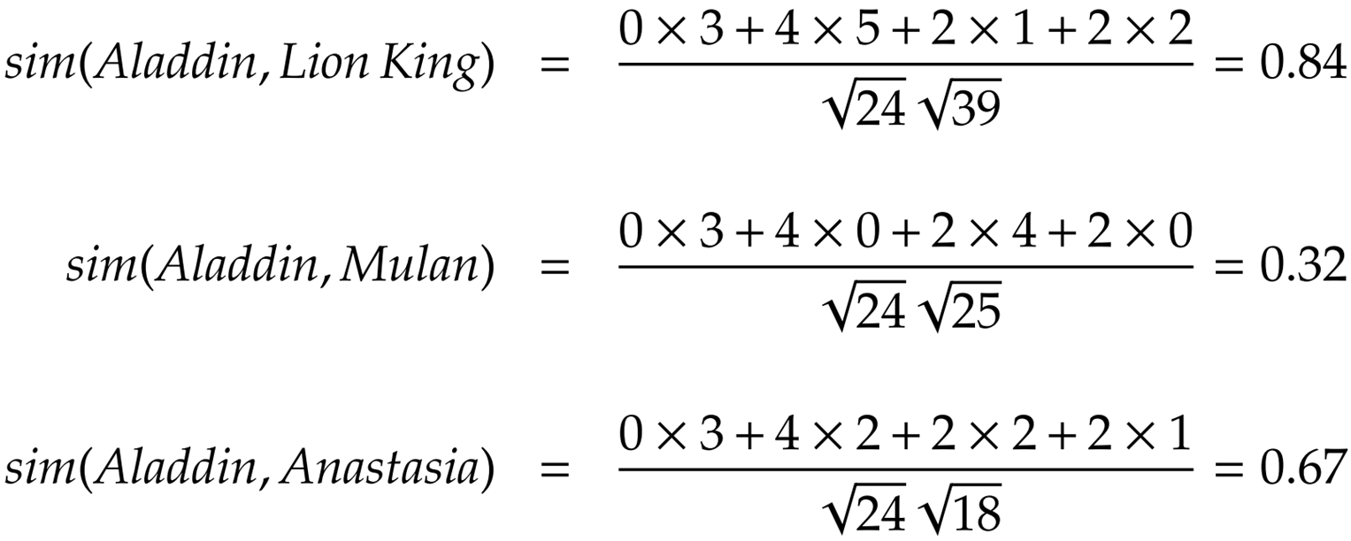
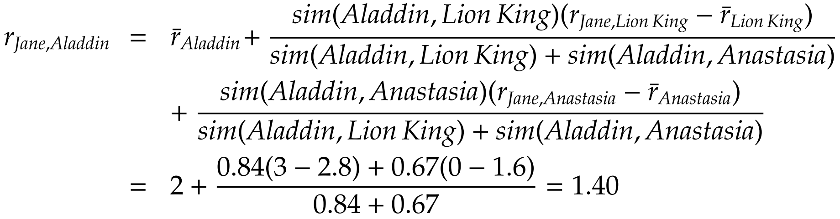
Item-based CF (Example)
1- Calculate average ratings
2- Calculate item-item similarity
3- Calculate Jane’s rating for Aladdin, Assume that neighborhood size = 2

Slide 22
Recommendation to a Group

Slide 23
Recommendation to a group
Find content of interest to all members of a group of socially acquainted individuals
Examples:
  A movie for friends to watch together
  A travel destination for a family to spend a break
  A good restaurant for colleagues to have lunch
  A music to be played in a public area

Slide 24
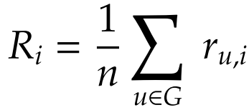


Aggregation Strategies
Maximizing Average Satisfaction
  Average everyone’s ratings and choose the max
Least Misery
  This approach tries to minimize the dissatisfaction among group’s members (max of all mins)
Most Pleasure
  The maximum of individuals’ maximum ratings is taken as group’s rating
Notes:
Non-Preference Aggregation (See the four methods in slide): Max(averages of all), Max(least’s of all), Max(max’s of all)
Preference Aggregation
Merging of recommendations made for individuals
Aggregation of ratings for individuals
Construction of group preference models

Slide 25
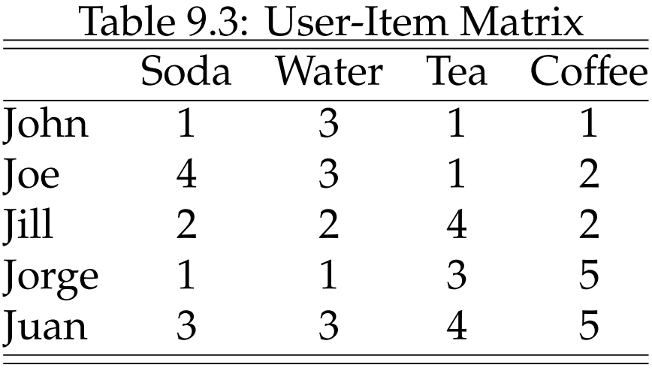
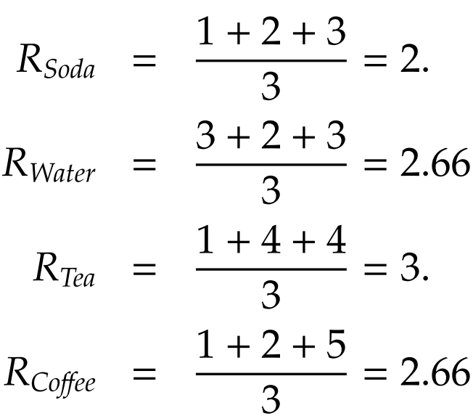
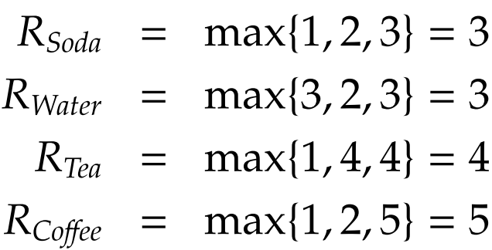
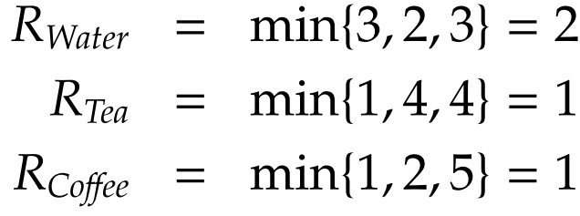
Recommendation to a group - Example
Let assume
a group of
John, Jill and Juan
Average Satisfaction
Least Misery
Most Pleasure
Tea wins
water wins
coffee wins
Notes:
Average Satisfaction

Slide 26
Evaluation of
Recommender Systems

Slide 27
The goal of a RS: users
Recommending a list of items of real interest to the user
Prediction of novel suggested items that the user was not aware of
Explanation of the reasons why the suggested items were recommended

Slide 28
The goal of a RS: service provider
Increase the number of sold items
  Because the recommended items are likely to suit the user's needs and wants
Sell more diverse items
  Using a RS the user can select items that might be hard to find without a precise recommendation
Increase the user satisfaction
  The user will find the recommendations interesting, relevant, and would enjoy using the system
Increase user fidelity
  A user should be loyal to a Web site which, when visited, recognizes the old customer and treats him as a valuable visitor

Slide 29
The goals for users may contradict the goals of service providers
It is clear that the goals of a user-side recommendation system often conflict with the goals of the service provider.
For example, the provider wants to sell the products left on the shelf, while the user wants to find new innovative products that will satisfy him.

Slide 30
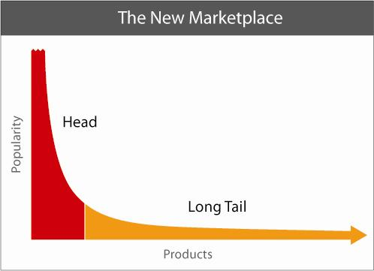
The Long Tail
item popularity distribution
Netflix (catalog of over 100,000 movie titles) rents a large volume of less popular movies in addition to the substantial business it does renting hits.
The Long Tail: the economic model in which the market for non-hits (typically large numbers of low-volume items) could be significant and sometimes even greater than the market for big hits (typically small numbers of high-volume items).
Notes:
FINO A QUI

Slide 31
Evaluating Recommender Systems
The majority focused on system’s accuracy in supporting the “find good items” user’s task
Assumption: if a user could examine all the available items, she could place them in an ordering of preference
  Measure how good is the system in predicting the exact rating value (Rating Prediction Task, MAE/RMSE)
  Measure how well the system can predict whether the item is relevant or not (Item Recommendation Task- Precision, Recall)
  Measure how close the predicted ranking of items is to the user’s true ranking (Item Recommendation Task -nDCG).
You need a metric to compare the predicted rating
(or recommendation or ranking) with the true rating
(or recommendation or ranking).
Notes:
Se il task e' diverso, allora queste metriche non vanno piu' bene.
Pensate al vostro task. Se per esempio devi fare una raccomandazione di gruppo devi adattare la metrica a quello che potrebbe essere il giudizio di un gruppo.

Slide 32
How Has Been Measured
Split the available data (so you need to collect data first!), i.e., the user-item ratings into two sets: training and test
Build a model on the training data
  For instance, in a nearest neighbor (memory-based) CF simply put the ratings in the training in a separate set
Compare the predicted ...
  rating on each test item (user-item combination) with the true rating stored in the test set
  recommendations with the really good recommendations (what are they?)
  ranking with the correct ranking (what is this?)
Notes:
We do not do cross validation because we have typically a lot of data.
We do not need to recycle the data.

Slide 33
Splitting the data
items
It does not work
users
train
test

Slide 34
Splitting the data
items
It does not work
users
train
test

Slide 35
Splitting the data
items
It works !
users
train
test

Slide 36
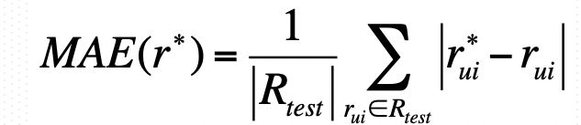
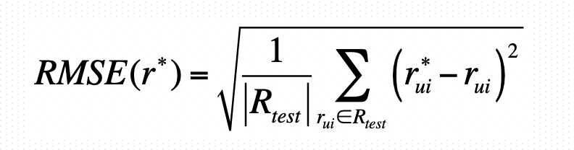
Accuracy: Comparing Values
Measure how close the predicted ratings are to the true user ratings (for all the ratings in the test set)
Predictive accuracy (rating): Mean Absolute Error (MAE), r*_{ui} is the predicted rating and r_{ui} is the true one:
It may be less appropriate for tasks such as Find Good Items – because people look only to top rated items
Every rating in the test set is considered equally important
Variation : penalize larger errors - Mean Squared Error (average the square of the differences), Root Mean Squared Error RMSE:
Notes:
It is not appropriate for “find good items” but it it has been used by these guys
MAE reflects more the accuracy for these users
We should compute the MAE for each user and then make the average.

Slide 37
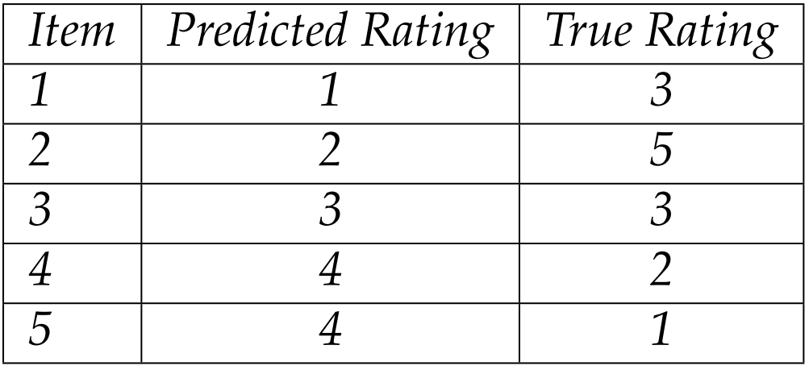
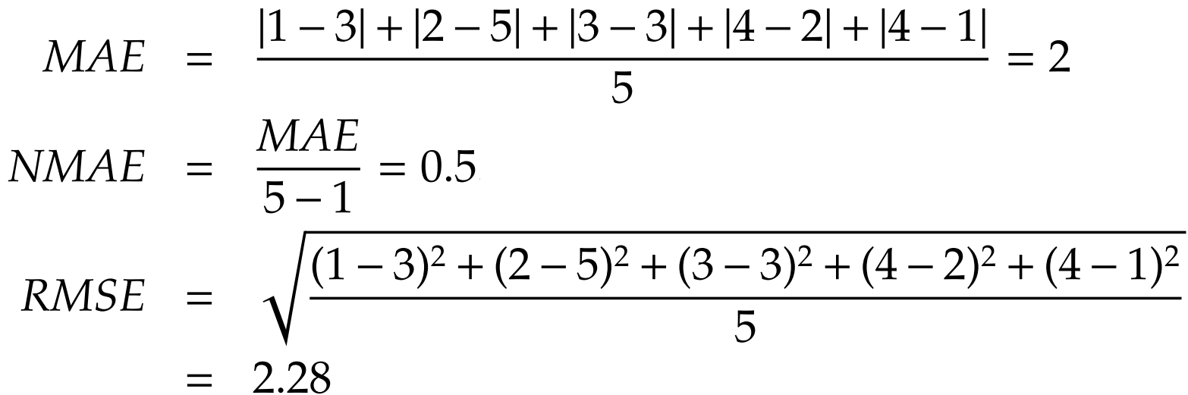
Rating Prediction Evaluation : Example

Slide 38
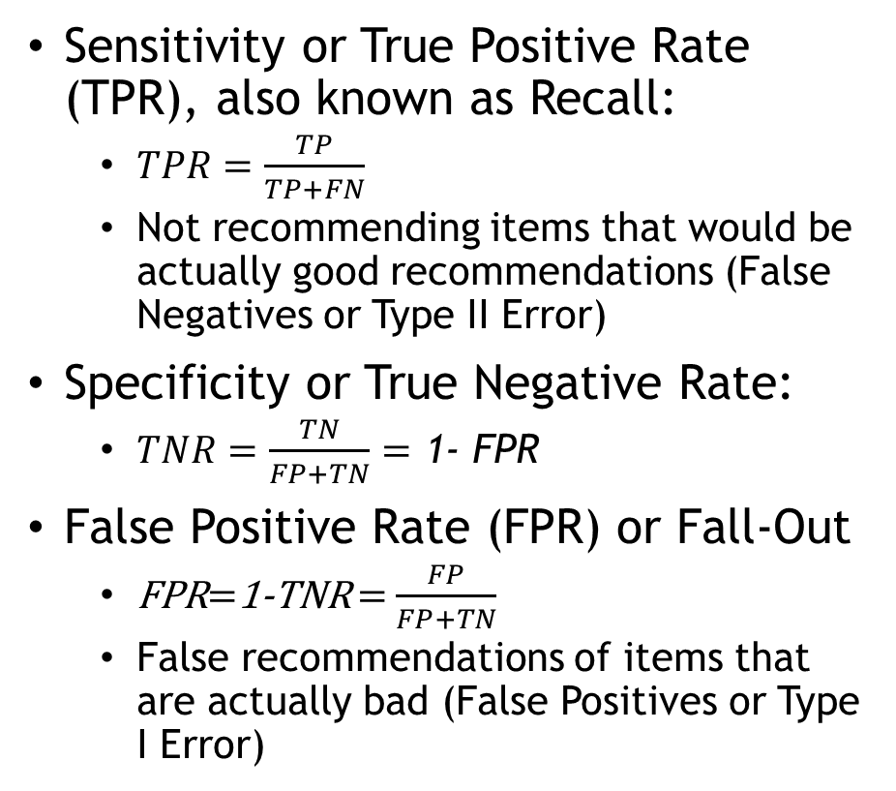
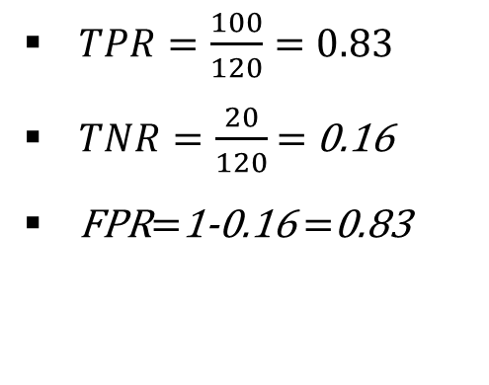
Performance of binary classification
A |  | Reality
 |  | Actually Good | Actually Bad
Prediction | Rated Good | 100 | 100 | 200
 | Rated Bad | 20 | 20 | 40
 |  | 120 | 120 | 240
I Error)
Notes:
Type I Error detects an effect that does not exist, falsely rejects null hypothesis, alpha value
Type II Error fails to identify an effect, incorrectly retains the null hypothesis, beta – power of a test (1-beta)

Slide 39
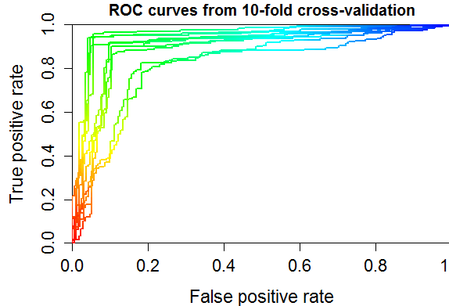
ROC Space
Best possible
predictor
Receiver Operating Characteristic
  Plot of FPR vs. TPR
  The diagonal represents the random guess
  i.e. length of recommendation list is varied
  ROC curves can be plotted
  AUC-ROC – area under ROC curve aggregates performance into one metric
Better
Worse
AUC – Area
under curve

Slide 40
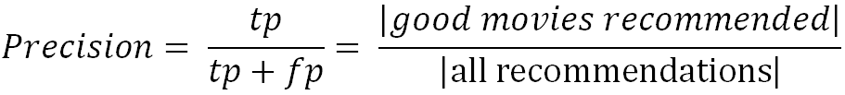
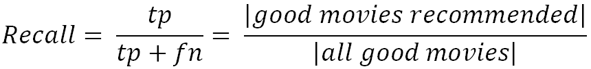
Metrics: Precision and Recall
Precision: a measure of exactness, determines the fraction of relevant items retrieved out of all items retrieved
  E.g. the proportion of recommended movies that are actually good
Recall (TPR): a measure of completeness, determines the fraction of relevant items retrieved out of all relevant items
  E.g. the proportion of all good movies recommended

Slide 41
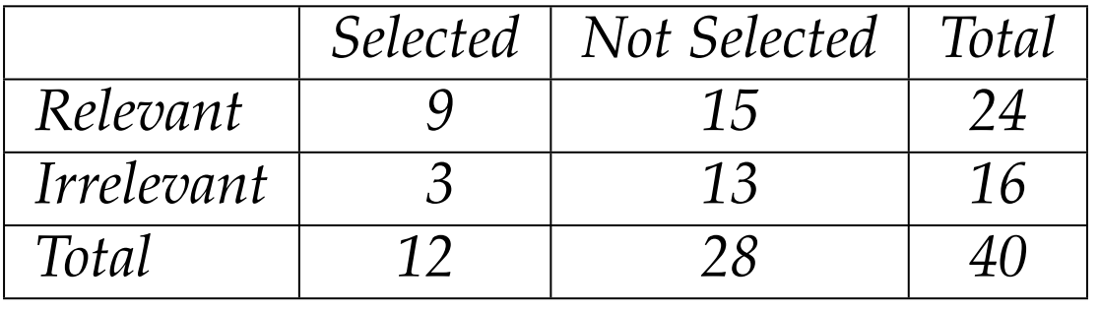
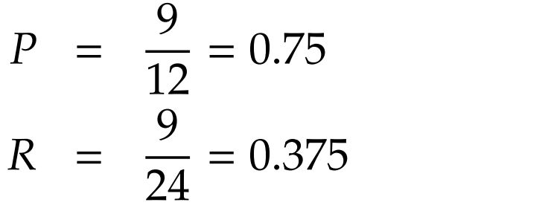
Precision and Recall Example

Slide 42
Precision@N recommended items
In a system which recommends a ranked list, the top-n items are the first n in the ranking.
Precision@n is the proportion of the top-n items that are relevant.
If r relevant items have been recommended at rank n, then:
Precision@n = 𝑟 / 𝑛

Slide 43
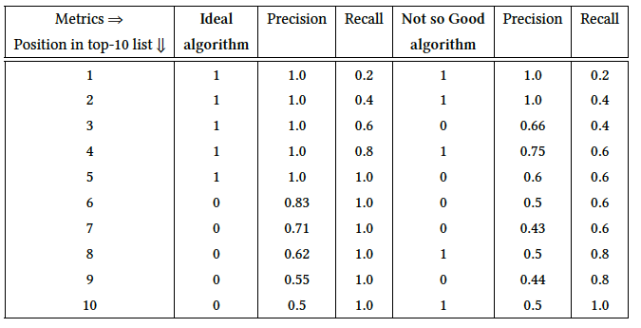
Example: Let's say we have 10 films in our film library, and 5 of them are liked by the target user.

Slide 44
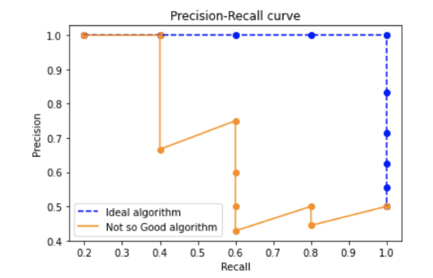
Example: Let's say we have 10 films in our film library, and 5 of them are liked by the target user.

Slide 45

Rank algorithms using precision and recall
Who "wins" for Precision@3?
 | Recommender A | Recommender B | Recommender C
Position | Ground truth | Ground truth | Ground truth
1 | 1 | 1 | 0
2 | 1 | 1 | 1
3 | 0 | 1 | 0
4 | 1 | 0 | 1
5 | 0 | 0 | 1

Slide 46
Handling of Unknown items
And now?
 | Recommender A | Recommender B | Recommender C
Position | Ground truth | Ground truth | Ground truth
1 | 1 | ? | ?
2 | ? | ? | 1
3 | ? | 1 | ?
4 | 1 | 0 | 1
5 | 0 | 0 | 1
Possible default assumptions:
  Unknown items are unknown
  Unknown items are bad

Slide 47
Quality of the produced ranking: NDCG
Discounted cumulative gain (DCG)
  Logarithmic reduction factor
Idealized discounted cumulative gain (IDCG)
  Assumption that items are ordered by decreasing relevance
  |h| cardinality of test set, assumption pos >= |h|
Normalized discounted cumulative gain (nDCG)
  Normalized to the interval [0..1]
Where:
pos denotes the position up to which relevance is accumulated
rel_{i} returns the relevance of recommendation at position i

Slide 48
Example nDCG
Rank | Hit?
1 | X
2 | ✅
3 | ✅
4 | ✅
5 | X
Further Reading: Chapter 8 from the book
Ricci, Francesco, Lior Rokach, and Bracha Shapira. Recommender systems handbook, 2015 (Second Edition).
https://edyaaleh.files.wordpress.com/2016/02/recommendersystemshandbook.pdf

Slide 49
Beyond Precision
Novelty is the ability of a RS to recommend items that the user was not already aware of
Explainability is the ability of a RS to recommend items that are *explainable* to the user based on this previous interactions
Coverage is the percentage of the items known to the RS for which the RS can generate predictions
User satisfaction metrics acquired with surveying the users or measuring retention and use statistics
Site performance metrics track an increase in items purchased or downloaded, an increase in overall user revenue, or an increase in overall user retention.

Slide 50







Diversity
I like Bruce Willis, but all these movies are almost the same!
This list is more to my liking.
I can decide whether I want a thriller, a drama, a comedy, or a feel-good movie!

Slide 51
Item Diversity (Intra-list Diversity)
Diversity is the opposite of similarity.
We assume that an item-item similarity metric is given.
We use the average distance between all pairs in the list as a list diversity level.
Distance metric based on content data
  Author
  Genre/Category
Further Reading: Chapter 26 from the book
Ricci, Francesco, Lior Rokach, and Bracha Shapira. Recommender systems handbook, 2015 (Second Edition).
https://edyaaleh.files.wordpress.com/2016/02/recommendersystemshandbook.pdf

Slide 52
Explanation Styles with textual description

Slide 53
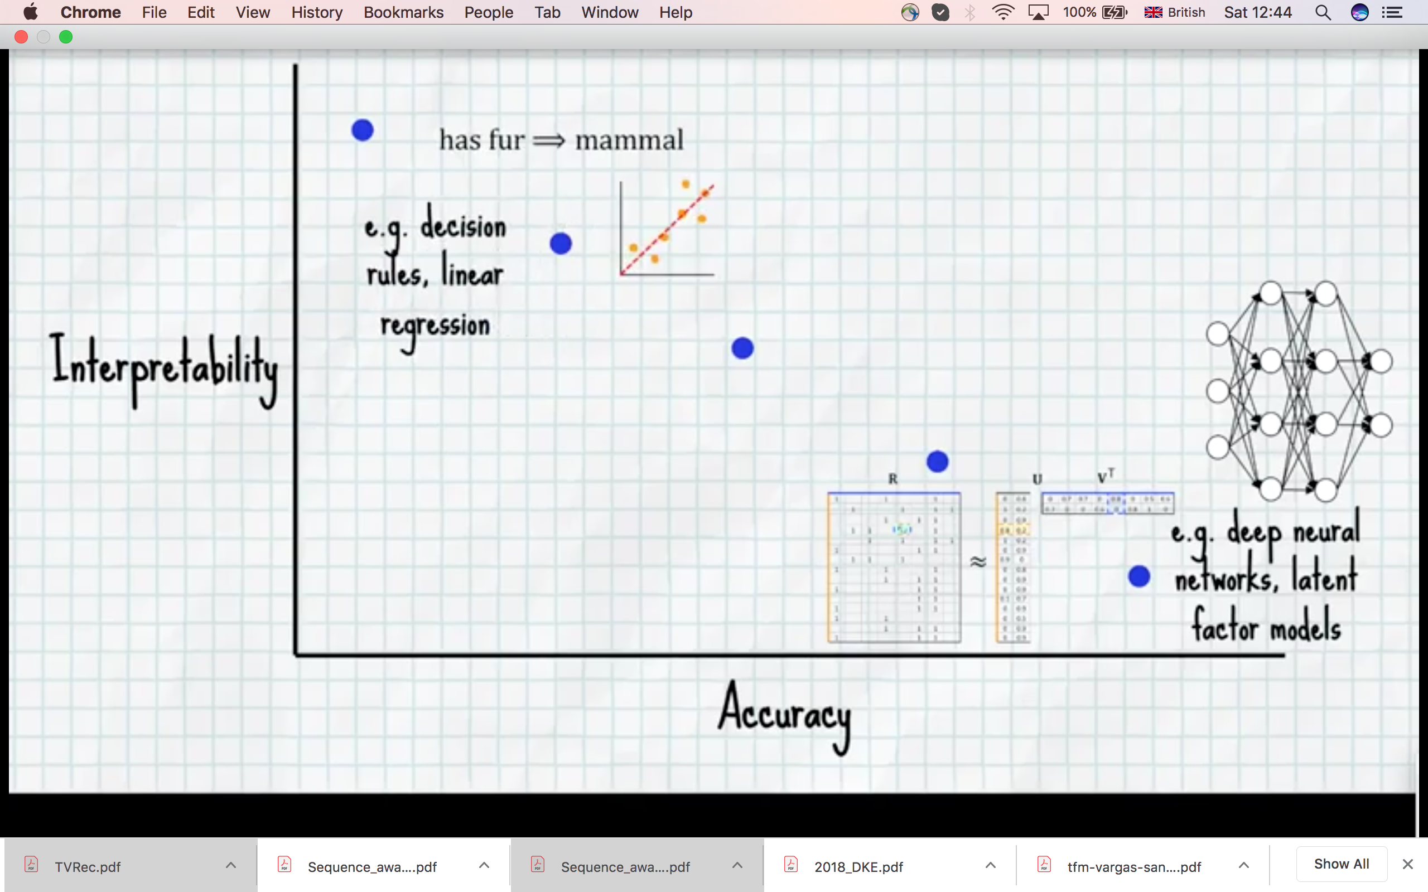
Interpretability vs. Accuracy

Slide 54
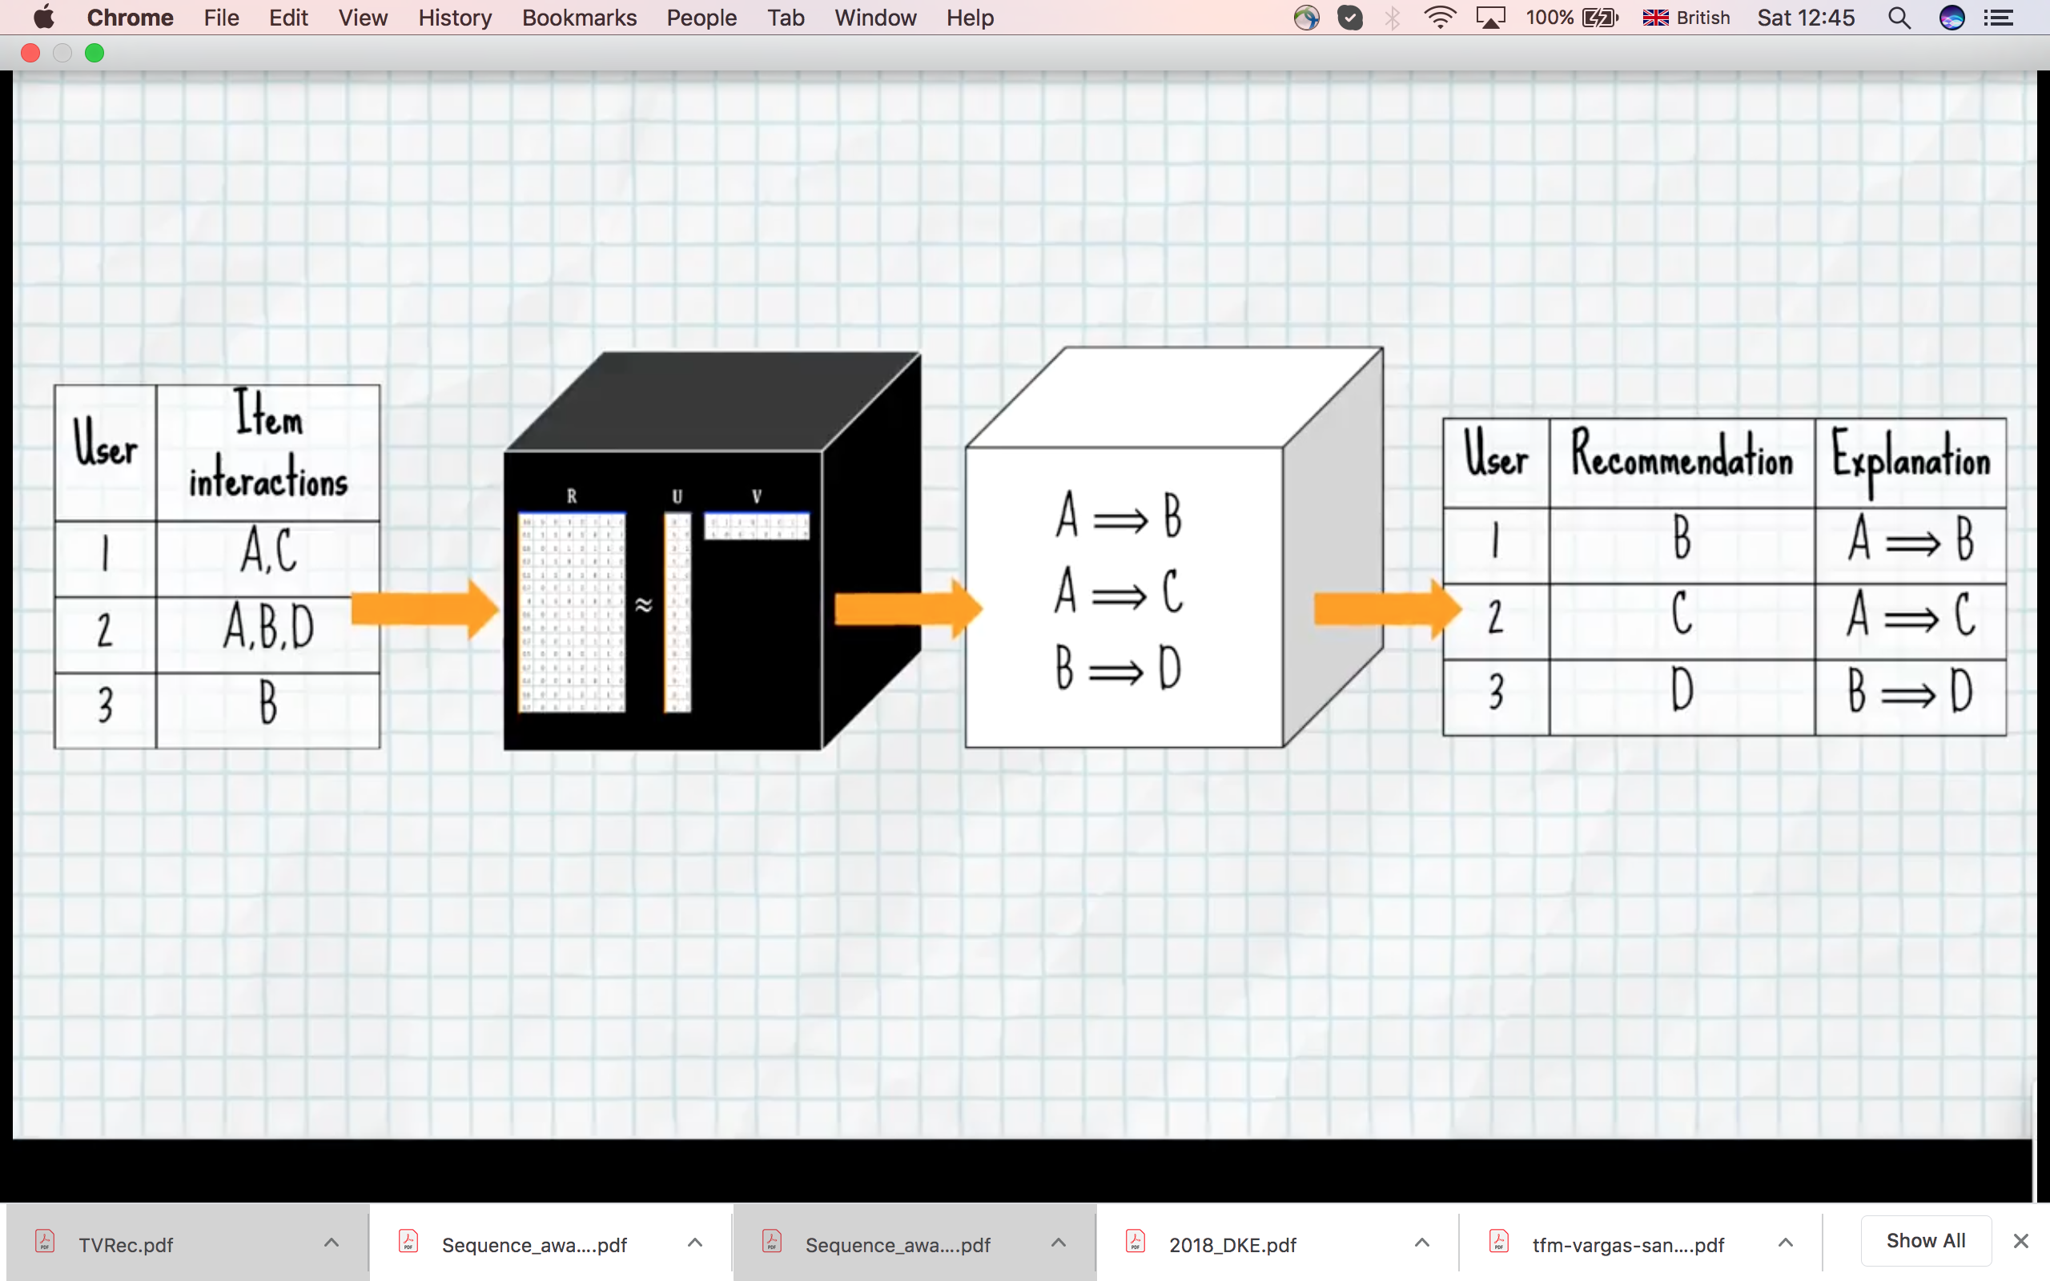
Explanation & Assoc. Rules

Slide 55
Measuring Explainability
Further Reading: Chapter 10 from the book
Ricci, Francesco, Lior Rokach, and Bracha Shapira. Recommender systems handbook, 2015 (Second Edition).
https://edyaaleh.files.wordpress.com/2016/02/recommendersystemshandbook.pdf

