Slide 1
TIME LAPSE EMBRYO MONITORING DOES IT ADD TO STANDARD IVF/ICSI?
Dr Anastasios Argyriou
Senior Clinical Embryologist MSc, PhD
Institute Of Life IVF Clinic, Athens, Greece
Co-Director of Post Graduate Studies,
University of West Athens, Greece

Slide 2
INTRODUCTION
Ultimate goal of an IVF program: a high live birth rate of healthy embryos
Critical steps in the laboratory phase:
- embryo culture
- proper evaluation of the available embryos
Objective:
To determine if the application of time-lapse incubation and monitoring can be
beneficial to clinical outcomes in assisted reproductive technology

Slide 3
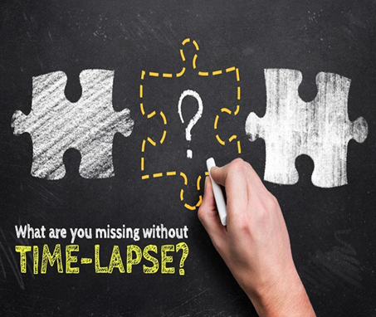
TIME LAPSE TECHNOLOGY
A TLT system typically comprises:
- a stand-alone incubator with one or more integrated inverted microscopes coupled to a camera
(digital images at regular time intervals and different focal planes of embryo development,
analysis with integrated TLT software), or
- an incorporated optical system in a conventional incubator
Benefits:
- uninterrupted culture of the dynamic assessment of developing embryos
- excellent temperature uniformity and gas recovery rates
- access to rich morphokinetic data
- objective embryo(s) ranking
- single embryo transfer (SET)
- accumulation of knowledge and experience

Slide 4
TIME LAPSE MONITORING SYSTEMS
Primo Vision (bright field, embryo culture in
multi-well dishes, Vitrolife)
Embryoscope (bright field, self contained
incubation up to 12 cultured embryos, Fertilitech)
Eeva (dark field, automatic embryo prediction
software, Early Embryonic Viability Assessment, Auxogyn)
Geri (16 micro-wells for individual embryo
tracking, a capacity to hold 96 embryos, Genea Biomedx)

Slide 5
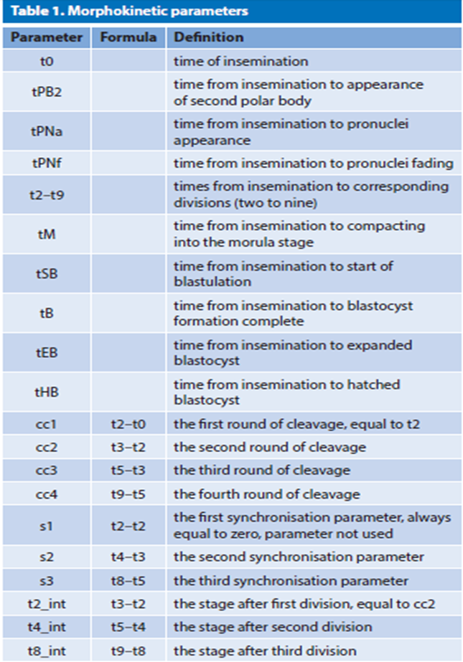
MORPHOLOGICAL AND KINETIC PARAMETERS
Morhological evaluation of the embryos at
specific time points
thickness of zona pellucida
pronuclear size and alignment (Sadowy et al., 1998)
multinucleation (Alikani et al., 2000)
blastomere fragmentation (Alikani et al., 1999)
blastocyst morphology (Gardner et al., 2000)
timing of cleavages (Johnson, 2002)
Kinetic parameters: dynamics of cleavage divisions,
compaction and cavitation on predetermined time

Slide 6
IMPACT OF TLT ON EMBRYO CULTURE CONDITIONS
Culture medium: No conclusive superiority of “sequential” or “single step” media with TLT incubators, in
terms of clinical outcomes (Hardarson et al., 2015; Kazdar et al., 2017 )
Oxygen tension: lower O2 levels in TLT incubators (Kovacic et al., 2010; Bontekoe et al., 2012)
Embryo density:
- in individual TLT culture :fewer cells at blastocyst stage, especially in the ICM (Kelley and Gardner, 2017)
- in multiple microwell type in TLT culture: better supports embryo development (Chung et al., 2015)
Reduced light exposure, in TLT incubators individual chambers (Li et al., 2014)

Slide 7
TLT FOR BLASTULATION
Blastocyst formation rates and blastocyst quality: correlation with early embryo division kinetics
(Cruz et al., 2012; Dal Canto et al., 2012; Hashimoto et al., 2012; Kirkegaard et al., 2013)
Early parameters (tPNf, t2, t3, t4, s1, s2, s3 ): good predictors of short-term development (day 3)
Late parameters (t5, t8, tM): better predictors of blastocyst formation (Herrero et al.,2013;Matato
et al.,2016)
TLT vs conventional incubators: better prediction for blastocyst formation due to lower O2
concentration (5% vs 20%) (Zaninovic et al., 2016)
CONCLUSION:
- the majority of these markers are related to the first two to
three days of development, allowing for early selection and transfer
- potentially preventing the drawbacks of prolonged culture, such as transfer
cancellation and possible epigenetic impacts

Slide 8
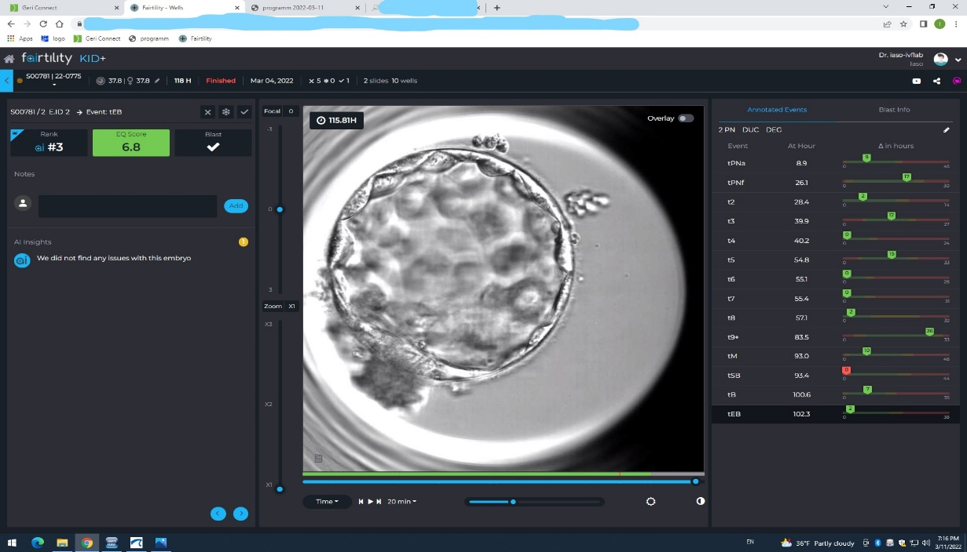
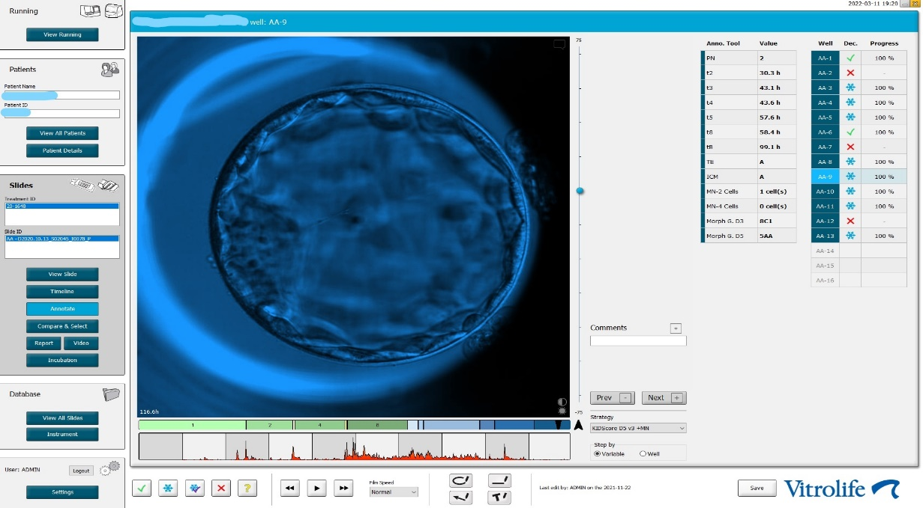
TLT AS A TOOL FOR BLASTOCYST SELECTION

Slide 9
TLT CAN ENHANCE EUPLOID EMBRYO SELECTION?
CONCLUSION:
the predictive value of morphokinetic parameters is not adequate to
replace PGT-A for aneuploidy screening.
TLT and PGT-A may improve the selection of euploid embryos with
the highest implantation potential

Slide 10
EVIDENCE OF A CLINICAL BENEFIT OF TLT
CONCLUSION:
Despite the current lack of evidence from RCTs for a clinical benefit of TLT:
continuous embryo monitoring in an undisturbed environment offers
more information into embryo development and
thus, enhances the identification of good-prognosis embryos
for increased % of pregnancy

Slide 11
TLT AND QUALITY CONTROL
Optimal culture conditions: the product of a good quality control system
(stable environment, detection of prematurely embryo-toxic conditions)
Time Lapse System: automatic information for culture conditions and embryo kinetics,
reduction of the time to check fertilization / embryo quality (automatic score), flexibility
in the laboratory organization
Control in thawed and PGT-A tested embryos: evaluation of % of survival
Internal Quality Control among Clinical Embryologists

Slide 12
TIME-LAPSE TECHNOLOGY AND ARTIFICIAL INTELLIGENCE
AI models have been trained to automatically score embryos related to their chance of
achieving a successful implantation
AI + TLT: - to extract information from image segmentation (circularity, radius, uniformity,
texture, luminosity and colour scale) using mathematical methods
- to grade embryos at the blastocyst stage (ICM and TE)
Advantages: non-invasive, faster than the human eye, % of success of the algorithm up to
92.5%, providing additional quantitative information for SET

Slide 13
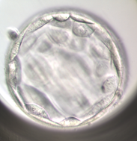
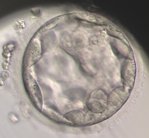
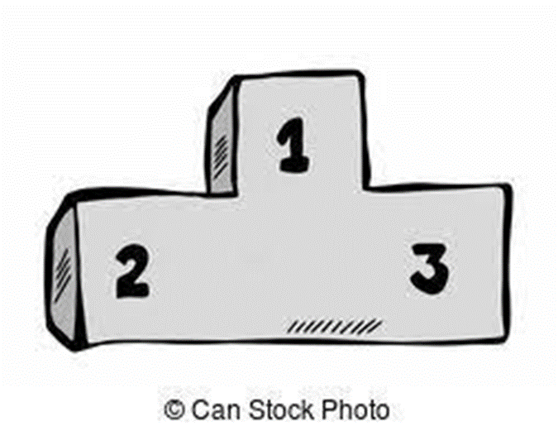
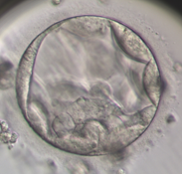
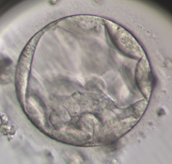
GRADING A BLASTOCYST
TRADITIONAL WAY
TLT + AI

Slide 14
TIME LAPSE TECHNOLOGY LIMITATIONS
- Knowledge relevant to embryo culture conditions, data management, cost-benefit balance
and its potential for research
- Requirement of technical and managerial expertise, need for specific training
- Insufficient studies to suggest that TLT can replace PGT-A in the identification of euploid
embryos

Slide 15
PAST, PRESENT AND FUTURE
1929: the first time-lapse analysis of the developing mammalian embryo (Lewis and Gregory, 1929)
2011: the first routine clinical use of time-lapse in the human IVF laboratory (Meseguer et al., 2011)
Today: TLT coupled with morphology, improves implantation and clinical pregnancy using algorithms and an artificial intelligence system to predict blastocyst quality (Khosravi et al., 2019) or to reproducibly identify images from blastocysts linked to a fetal heartbeat (Tran et al., 2019)
Fluorescence and confocal TLT: observation of morphokinetics of organelles and chromosomes during oocyte maturation (Zielinska et al., 2015; Capalbo et al., 2017), discovering the physiology of the cell, since many metabolites and enzymes exhibit auto fluorescent properties (Gosnellet al., 2016), as biomarkers of viability

Slide 16
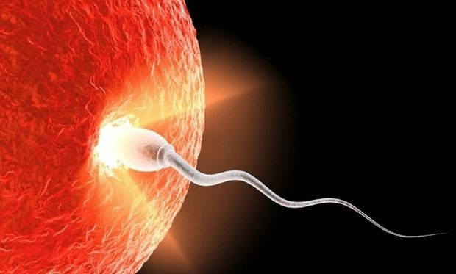
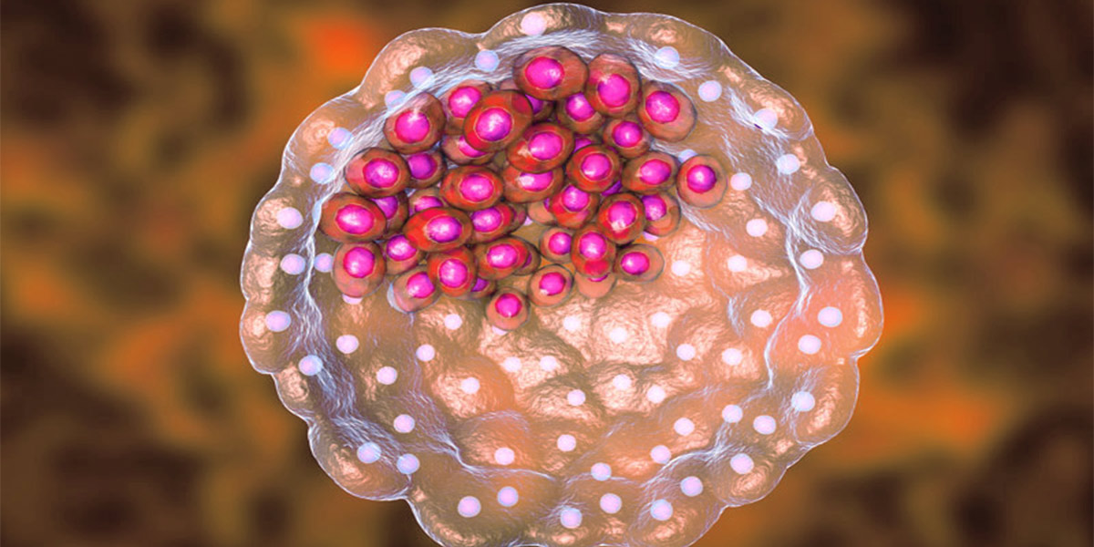
THANK YOU FOR YOUR ATTENTION

