Slide 1
Data Analytics Classification & Prediction
Periklis Andritsos
pandritsos@uniwa.gr

Slide 2
Chapter 6. Classification and Prediction
What is classification? What is prediction?
Issues regarding classification and prediction
Classification by decision tree induction
Bayesian classification
Rule-based classification
Classification by back propagation
Support Vector Machines (SVM)
Associative classification
Lazy learners (or learning from your neighbors)
Other classification methods
Prediction
Accuracy and error measures
Ensemble methods
Model selection
Summary

Slide 3
Classification vs. Prediction
Classification
predicts categorical class labels (discrete or nominal)
classifies data (constructs a model) based on the training set and the values (class labels) in a classifying attribute and uses it in classifying new data
Prediction
models continuous-valued functions, i.e., predicts unknown or missing values
Typical applications
Credit approval
Target marketing
Medical diagnosis
Fraud detection

Slide 4
Classification—A Two-Step Process
Model construction: describing a set of predetermined classes
Each tuple/sample is assumed to belong to a predefined class, as determined by the class label attribute
The set of tuples used for model construction is training set
The model is represented as classification rules, decision trees, or mathematical formulae
Model usage: for classifying future or unknown objects
Estimate accuracy of the model
The known label of test sample is compared with the classified result from the model
Accuracy rate is the percentage of test set samples that are correctly classified by the model
Test set is independent of training set, otherwise over-fitting will occur
If the accuracy is acceptable, use the model to classify data tuples whose class labels are not known

Slide 5
Process (1): Model Construction
Classification
Algorithms
Training
Data
Classifier
(Model)
IF rank = ‘professor’
OR years > 6
THEN tenured = ‘yes’

Slide 6
Process (2): Using the Model in Prediction
Classifier
Testing
Data
Unseen Data
(Jeff, Professor, 4)
Tenured?

Slide 7
Supervised vs. Unsupervised Learning
Supervised learning (classification)
Supervision: The training data (observations, measurements, etc.) are accompanied by labels indicating the class of the observations
New data is classified based on the training set
Unsupervised learning (clustering)
The class labels of training data is unknown
Given a set of measurements, observations, etc. with the aim of establishing the existence of classes or clusters in the data

Slide 8
Chapter 6. Classification and Prediction
What is classification? What is prediction?
Issues regarding classification and prediction
Classification by decision tree induction
Bayesian classification
Rule-based classification
Classification by back propagation
Support Vector Machines (SVM)
Associative classification
Lazy learners (or learning from your neighbors)
Other classification methods
Prediction
Accuracy and error measures
Ensemble methods
Model selection
Summary

Slide 9
Issues: Data Preparation
Data cleaning
Preprocess data in order to reduce noise and handle missing values
Relevance analysis (feature selection)
Remove the irrelevant or redundant attributes
Data transformation
Generalize and/or normalize data

Slide 10
Issues: Evaluating Classification Methods
Accuracy
classifier accuracy: predicting class label
predictor accuracy: guessing value of predicted attributes
Speed
time to construct the model (training time)
time to use the model (classification/prediction time)
Robustness: handling noise and missing values
Scalability: efficiency in disk-resident databases
Interpretability
understanding and insight provided by the model
Other measures, e.g., goodness of rules, such as decision tree size or compactness of classification rules

Slide 11
Chapter 6. Classification and Prediction
What is classification? What is prediction?
Issues regarding classification and prediction
Classification by decision tree induction
Bayesian classification
Rule-based classification
Classification by back propagation
Support Vector Machines (SVM)
Associative classification
Lazy learners (or learning from your neighbors)
Other classification methods
Prediction
Accuracy and error measures
Ensemble methods
Model selection
Summary

Slide 12
Decision Tree Induction: Training Dataset
This follows an example of Quinlan’s ID3 (Playing Tennis)

Slide 13
Output: A Decision Tree for “buys_computer”
age?
<=30
overcast
>40
31..40
student?
yes
credit rating?
no
yes
excellent
fair
no
yes
no
yes

Slide 14
Algorithm for Decision Tree Induction
Basic algorithm (a greedy algorithm)
Tree is constructed in a top-down recursive divide-and-conquer manner
At start, all the training examples are at the root
Attributes are categorical (if continuous-valued, they are discretized in advance)
Examples are partitioned recursively based on selected attributes
Test attributes are selected on the basis of a heuristic or statistical measure (e.g., information gain)
Conditions for stopping partitioning
All samples for a given node belong to the same class
There are no remaining attributes for further partitioning – majority voting is employed for classifying the leaf
There are no samples left

Slide 15
Attribute Selection Measure: Information Gain (ID3/C4.5)
Select the attribute with the highest information gain
Let p_{i} be the probability that an arbitrary tuple in D belongs to class C_{i}, estimated by |C_{i, D}|/|D|
Expected information (entropy) needed to classify a tuple in D:
Information needed (after using A to split D into v partitions) to classify D:
Information gained by branching on attribute A
Notes:
I : the expected information needed to classify a given sample
E (entropy) : expected information based on the partitioning into subsets by A

Slide 16
Attribute Selection: Information Gain
Class P: buys_computer = “yes”
Class N: buys_computer = “no”
means “age <=30” has 5 out of 14 samples, with 2 yes’es and 3 no’s. Hence
Similarly,

Slide 17
Computing Information-Gain for Continuous-Value Attributes
Let attribute A be a continuous-valued attribute
Must determine the best split point for A
Sort the value A in increasing order
Typically, the midpoint between each pair of adjacent values is considered as a possible split point
(a_{i}+a_{i+1})/2 is the midpoint between the values of a_{i} and a_{i+1}
The point with the minimum expected information requirement for A is selected as the split-point for A
Split:
D1 is the set of tuples in D satisfying A ≤ split-point, and D2 is the set of tuples in D satisfying A > split-point

Slide 18
Overfitting and Tree Pruning
Overfitting: An induced tree may overfit the training data
Too many branches, some may reflect anomalies due to noise or outliers
Poor accuracy for unseen samples
Two approaches to avoid overfitting
Prepruning: Halt tree construction early—do not split a node if this would result in the goodness measure falling below a threshold
Difficult to choose an appropriate threshold
Postpruning: Remove branches from a “fully grown” tree—get a sequence of progressively pruned trees
Use a set of data different from the training data to decide which is the “best pruned tree”

Slide 19
Enhancements to Basic Decision Tree Induction
Allow for continuous-valued attributes
Dynamically define new discrete-valued attributes that partition the continuous attribute value into a discrete set of intervals
Handle missing attribute values
Assign the most common value of the attribute
Assign probability to each of the possible values
Attribute construction
Create new attributes based on existing ones that are sparsely represented
This reduces fragmentation, repetition, and replication

Slide 20
Classification in Large Databases
Classification—a classical problem extensively studied by statisticians and machine learning researchers
Scalability: Classifying data sets with millions of examples and hundreds of attributes with reasonable speed
Why decision tree induction in data mining?
relatively faster learning speed (than other classification methods)
convertible to simple and easy to understand classification rules
can use SQL queries for accessing databases
comparable classification accuracy with other methods

Slide 21
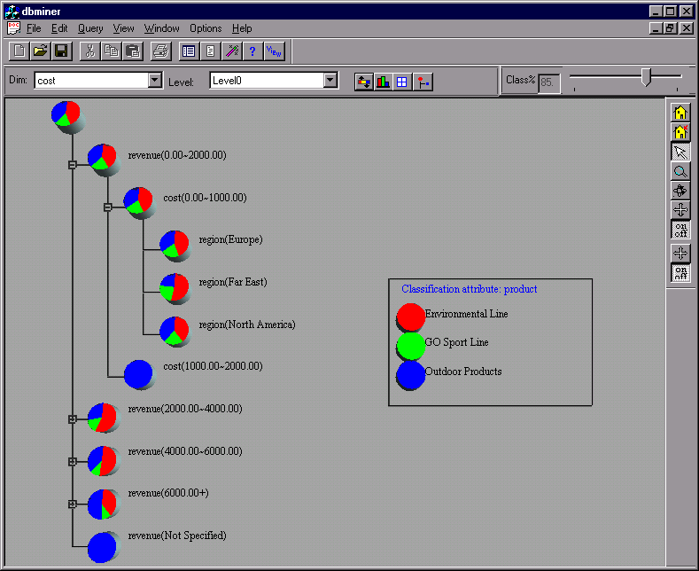
Presentation of Classification Results

Slide 22
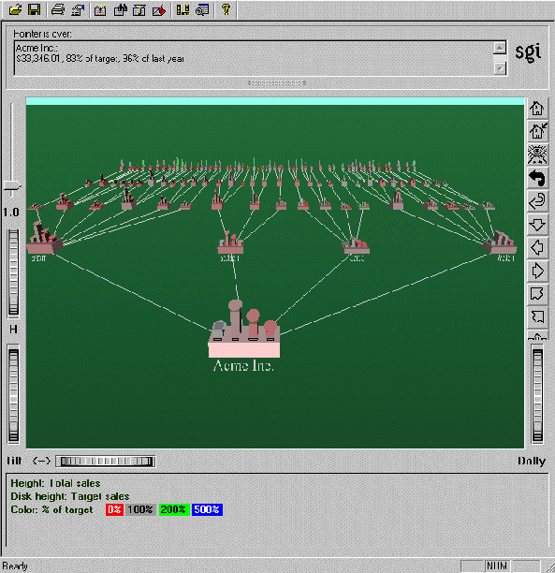
Visualization of a Decision Tree in SGI/MineSet 3.0

Slide 23
Linear Classification
Binary Classification problem
The data above the red line belongs to class ‘x’
The data below red line belongs to class ‘o’
Examples: SVM, Perceptron, Probabilistic Classifiers
x
x
x
x
x
x
x
x
o
x
o
x
o
o
o
o
o
o
o
o
o
o
o

Slide 24
SVM—General Philosophy
Small Margin
Large Margin
Support Vectors

Slide 25
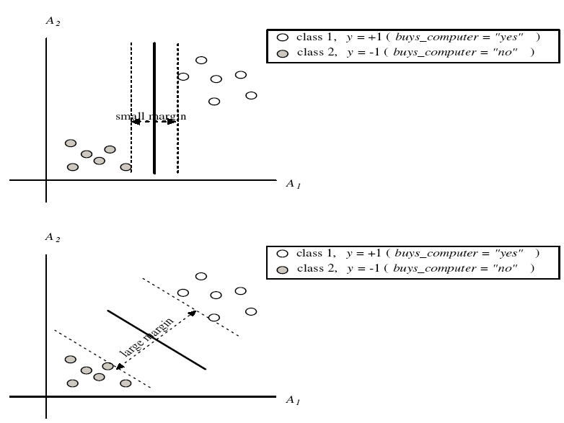
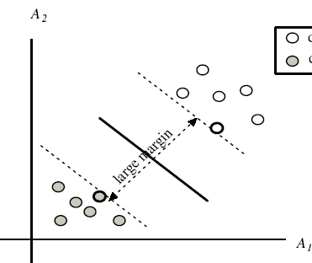
SVM—Margins and Support Vectors

