Slide 1
Character Design for Animation
Panagiotis (Takis) Kyriakoulakos
Assistant Professor in Computer Animation
Department of Product and Systems Design Engineering
School of Engineering, University of the Aegean
ERASMUS+ Conference
ENSAD, 9/5/2022

Slide 2
Educational Background
Dr P. Kyriakoulakos is Assistant Professor in Computer Animation at the Department of Product and Systems Design Engineering of the University of the Aegean. Prior to that, he served as Lecturer in Computer Animation (2010-2018) at the same Department. He holds a Diploma in Electrical Engineering from the Aristotle University of Thessaloniki, a Master’s Degree (DEA) “Cinema, Television, Audiovisuel” from the Universities Paris 1 and Paris 10, and a Ph.D. (Doctorat) in Sciences of Art from the University of Paris 10. For his studies in Paris, P. Kyriakoulakos received a 3-year Grant from Onassis Foundation.
He has extensive experience in Teaching and Digital Production activities both in Greece and France since 1987, including Expertise for the MEDIA Programme of the European Union (Development and Training Proposals Evaluations). He served as Adjunct Lecturer at the UFR d’Arts Plastiques et Sciences de l’Art of Paris 1 University - Pantheon/Sorbonne (1987-1992) and at the Department of Product and Systems Design Engineering (2000-2010). P. Kyriakoulakos received the Award of SCAM (societe civile des auteurs multimedia) in 1991 as Editor-in-Chief of the video-magazine La Vague, Arts en Video, published in Paris.

Slide 3
Professional and Research Activities
As Managing Director of Post Reality (1994-2006) and New Media Director for PLD Production (2006-2010), as well as a stockholder of Fantasia Audiovisual Ltd (1996-2012), he produced several audiovisual, computer animation and multimedia works, including the first Greek 30 min long computer animated TV special Alexandra Meets the Space Toons (2003) for the Public Broadcaster ERT, and launched the pilot version of the Video-on-Demand Platform Homeweb (2010). Member of the Interactive Systems Design Laboratory of the Faculty since its foundation year 2000, Dr Kyriakoulakos participated in several Research Programmes, including the internationally awarded ARCHEOGUIDE (2000-2002) and HIST3D (2011-2015).
His Research Interests include topics on the Creative Process in Computer Animation and Digital Media and on the impact of the Techniques on the Aesthetics of Animation and Interactive works. He is the Scientific Coordinator of the International Conference and Summer School on Extended Arts (XARTS) since 2013. Dr Kyriakoulakos received the Grant of Excellence Research in Paris 2013 from the City of Paris to conduct research in ENSADLab, IRCAV-Paris 3 University, INHA and Inatheque in Paris, in the context of HIST3D Research framework.
Dr Kyriakoulakos received the title of Chevalier des Palmes Academiques by the French Ministry of Education (2014) for his commitment to the French-Greek Cooperation in the Sectors of Education and Culture. He serves as Vice-President of ASIFA Hellas since 2015.

Slide 4
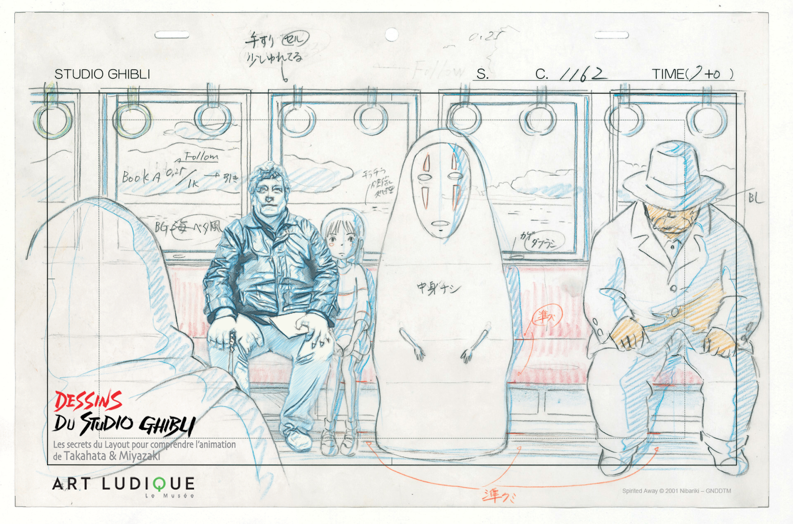
Musee Ludique (Paris): Studio Ghibli Layouts

Slide 5
Animation Cinema
Animation Timeline
Analytical Tools (Narrative, Experimental, Developmental)
Character Perception Theories (Understanding Animation by Paul Wells)
Design for Personality (Leslie Bishko in The Animation Bible by Maureen Furniss)
The Heroe’s Journey https://www.youtube.com/watch?v=Hhk4N9A0oCA&t=2s
Reference based Design https://www.youtube.com/watch?v=K_QAeicX-Rw

Slide 6
An Anthropological Approach
Adopting the methodology of Anthropologists, some of the theorists of Animation try to discover entanglements, affordances and dependencies between the creators and the animated works, unveiling patterns and trends that resist over time and sometimes show a developmental course (5).

Slide 7
The importance of historical data
By juxtaposing important developments in the History of Animation in a timeline from 1892 to now we can travel through 3 ages of Animation (pre-cinema, cinema, digital), understand that European Animators contributed significant advances to the aesthetic content and to the meaning of animated works while US Animators leaded the way to standardize the production process, and appreciate the role of the dissemination (festivals, education, cinema theaters, television, digital distribution) in the making of animated works (6, 7).

Slide 8
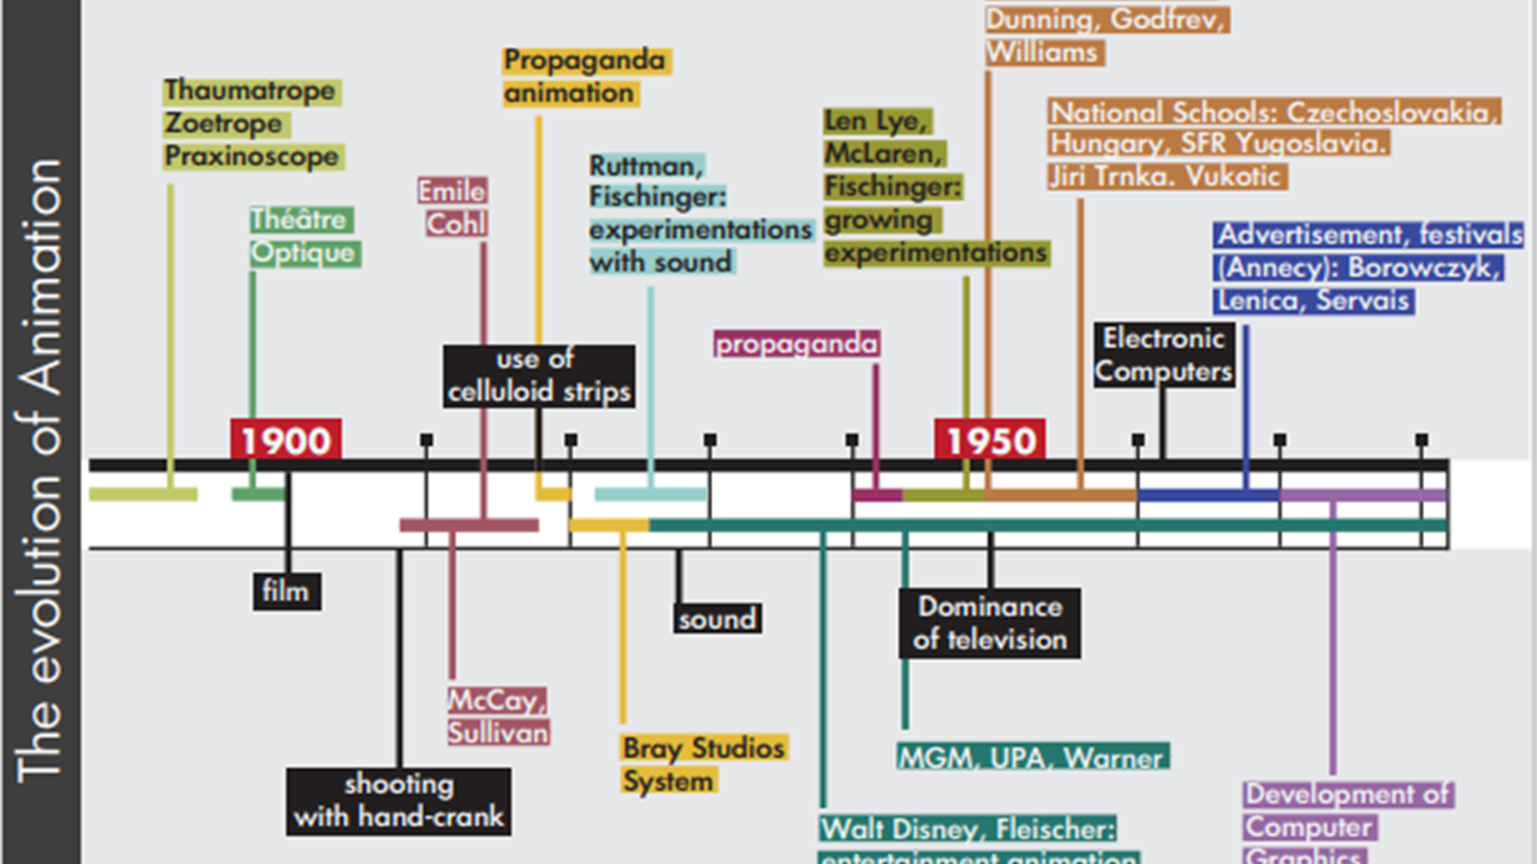

Slide 9
Orthodox versus Experimental
Configuration vs Abstraction
Specific Continuity vs Specific Non-Continuity
Narrative Form vs Interpretative Form
Evolution of Context vs Evolution of Materiality
Unity of Style vs Multiple Styles
Absence of Artist vs Presence of the Artist
Dynamics of Dialogue vs Dynamics of Musicality

Slide 10
The importance of Design
By further examining the changes occurring over time in the practice, process, and production of animated works we can observe interesting evolutions. Animation practice seems to involve a creative team rather than one creator and to be regulated by more design than before (8), as exemplified by the communication of various design documents such as storyboards and animation bibles between the members of the creative team (9).

Slide 11
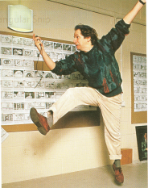

Slide 12
The importance of Dissemination
Both the creative and the production processes incorporate applied research during the development stage, proposing solutions to creative problems and adapting production pipelines to the needs of the animated work.
The production of the work itself changes to accommodate the needs for dissemination such as pitching expectations, distribution deadlines, and merchandising deals (10).

Slide 13
The importance of Evolutive Ecosystems
The changes observed in Animation Practice over time merit a wider framework of Research tools, notions, and strategies, adopting Anthropological methods to understand the thingness of Animation, i.e. how creators and their works are forming evolutive ecosystems (11). This paper attempts to put the premises of an 'Animation Practice as Research' framework, giving to the researchers both the vocabulary and the context to design and deliver Research outcomes.

Slide 14
Development Stages
Development Category | Deliverables
Early Stage | Draft Script, Sample Storyboard, Literary Bible, Character Design, Sample Set Design, Animation tests, Possibly Pilot
Late Stage | Revised Script, Production Storyboard, Graphic Bible, Advanced Character Design, Advanced Set Design, Voice casting, Animatic, Production Pipeline Tests, Animation teaser

Slide 15
Theoretical Considerations
As far as theoretical notions are concerned, Visual, Cinema and Digital Media Anthropological theories provide useful methods to question the Artistic Praxis (12), the Production Process (13), and the Meaning of the Animation Techniques (14). It is interesting to note though, despite the entanglements, affordances and dependencies observed between cinema and animation (15, 16), that influential Animation theorists provide also adequate tools to link the techniques to the aesthetics of the animated works (17, 18).

Slide 16
Practical Considerations
Last, as far as the Research context is concerned, we can observe good practice in Training Networks, Audiovisual Institutes, Residencies, Research Networks, University Laboratories, but not yet an International Doctoral School in 'Animation Practice as Research', partially due to the lack of an adequate framework, certainly due to the time needed to research, like archaeologists do, an important number of data covering many years of creative practice. An insight on how to design an 'Animation Techniques versus Aesthetics' framework for master's degree theses will clarify the mechanics of doing 'Animation Practice as Research' in a Design Engineering Department (19).

Slide 17
Animation Production Figures
Film Category | Film Duration | Shots Number | Production Duration | Production Cost (US Dollars)
Feature 2D/CGI | 75-85’ | 1250-1500 | 2-3,5 years | 15.000.000-120.000.000
Feature 3D/CGI | 75-85’ | 1350-1700 | 2-3,5 years | 25.000.000-100.000.000
Network series- 2D/3D | 22’ | 350 | 14-18 weeks per episode | 300.000-450.000
TV Specials- 2D/3D | 22’ | 450-600 | 9-15 months | 650.000-1.000.000
Shorts- 2D/3D | 7’ | 60-130 | 3-6 months | 75.000-650.000

Slide 18
Character Comedy Design Theory
Cartoon character (Klein)
Controller, Over-reactor, Nuisance
Comedy character (Jenkins)
The clown, Dupe/Killjoy, Counterfeit – C0mic antagonist
Psychanalytic (Freud)
Id (Bugs Bunny), Super ego (Elmer Fudd), Ego (Daffy Duck)
https://www.youtube.com/watch?v=17ocaZb-bGg

Slide 19
Character Design for Animation
Design for Personality (Leslie Bishko in The Animation Bible by Maureen Furniss)
The Heroe’s Journey https://www.youtube.com/watch?v=Hhk4N9A0oCA&t=2s
Reference based Design https://www.youtube.com/watch?v=K_QAeicX-Rw

Slide 20
References (1)
Kyriakoulakos, P. (2019). The Praxis in Computer Animation: figurative, interactive, engaging, playful. Anifest, Interactive Animation and Video Games Symposium, Canterbury, 8/3/2019. Not yet published. The Digital Age of Animation acts sometimes as a launch pad to re-consider the Animation Practice in general. Admitting that creativity goes hand by hand with frustration is important for animation practitioners. Practitioners and Artists using Maya Computer Animation Software depicted this issue in recent surveys (Wood, A. (2013). Talking about Maya [pdf]. Available at: http://www.kent.ac.uk/arts/staff-profiles/profiles/film/wood.html.) See in the final remarks: “Though the word frustration looms large, flexible and versatile also feature strongly (…) One of the features of Maya is its versatility”.
Kyriakoulakos, P. (2015). "De l’infographiste à l’infographe: l’invention d’un métier." CinémAction 155: 119-124. The way to progressively turn a constraint to an advantage, inventing at the same time the profession of Computer Animator, is stressed out in this essay.
Back in 2016 in Singapore during the presentation of a new volume of his Animation History at the SAS Conference, Giannalberto Bendazzi explained, in a Q&A session with the audience, why most of the examples referred in his books are short animated films, instead of TV series for instance, by insisting in the originality, creativity, and artistic accomplishments of this short animation format.
Jones, Chuck (1974). "Animation is a Gift Word." AFI Report (Vol. 5, No 2), Summer 1974. This seminal text takes position for the creative practice in animation as opposed to the first limited animation series screening in television.
Wells, P. (2011). "From 'Sunnyside' to 'soccer': reading up on animation." Animation Practice, Process & Production, Vol.1, No1, intellect: 3-9. This editorial to the first issue of AP3 draws on the many faces of animation and the impact of the medium to the creators as well as the audience.

Slide 21
References (2)
(6) Pagiatis, P. (2007). Design of Animation based on the fabrication technique: the aesthetics of sand, Master Thesis, University of the Aegean, Syros [in Greek]. This thesis contains the timeline presenting the evolution of European and US Animation over time as an example of practice and process diagram.
(7) Kyriakoulakos P. et al (2016). 70 Years of Greek Animation, ASIFA Hellas [bilingual English Greek]. This album contains a timeline depicting firsts, prizes, and awards of Greek Animation from 1945 to 2015 as an example of production and dissemination diagram.
(8) Lord, P. and B. Sibley (1998). Creating 3-D Animation. The Aardman Book of Filmmaking, Harry N. Abrams, Inc, Publishers. This book illustrates the art of Aardman animation but the picture in p. 130 is worth a thousand words: Nick Park performs a character's movement by acting and timing at the same time in front of a wall covered by the storyboard of the film in production in the studios. His creative act is fully supported by a creative team: there is a storyboard on the wall…
(9) Organised at La Maison de la Recherche of the University of Paris 3 on June 6, 2017, the international meeting 'La Fabrique de l'Animation' united scholars and practitioners from UK, Canada, USA, France, and Italy to discuss the making of animated films and the design documents related to their fabrication.
(10) Kyriakoulakos, P. (2016). "Secrets and Lies in the 3D Animation Production". In 70 Years of Greek Animation, ASIFA Hellas: 162-169.

Slide 22
References (3)
(11) Hodder, Ian. (2018). Where Are We Heading? The Evolution of Humans and Things, Yale University Press. Critical notions such as entanglements, affordances, and dependencies between humans and things are defined in this book and put in context.
(12) Leroi-Gourhan, A. (1964). Le geste et la parole, Albin Michel, Paris, especially chapter 14: “Le langage des formes”. Form, Detail and Finesse are among the characteristics of the designed things described by the French Paleontologist.
(13) de France, Cl. (2010). « L'Analyse praxéologique. Composition, ordre et articulation d'un procès », Techniques & Culture [On Line], 54-55 | consulted on October 1st, 2020. URL : http://journals.openedition.org/tc/5000 ; DOI : https://doi.org/10.4000/tc.5000. The analogies between time and space in the process of making things, especially films, are in the core of the analysis in this paper.
(14) Bachimont, Bruno (2010). Le sens de la technique: le numerique et le calcul, Edirions Les Belles Lettres. A book on the importance of techniques in supporting learning. It describes the balance between the Engineer and the Artist who are both based in the same fabrication continuum.
(15) Denis, S. (2017). Le cinéma d'animation - 3e éd. - Techniques, esthétiques, imaginaires: Techniques, esthétiques, imaginaires (Cinéma / Arts Visuels) (French Edition). The term of Cinema Animation is invented in France: Curricula in the main professional schools and Universities in France are described as Cinema Animation, heavily influenced by the use of cinematographic techniques

Slide 23
References (4)
(16) Sifianos, G. (2012). Esthétique du cinéma d'animation (Septième Art) (French). Sifianos defines animation as a cinematographic process which is using non dissimulating conventions.
(17) Furniss, M. (1998). Art in Motion: Animation Aesthetics, John Libbey Publisher. Important remarks on how to conduct Research in Animation are combined with an inspiring definition of the animation continuum between mimesis and abstraction. The Aristotelian term of Mimesis should be understood as simulation, i.e. a fictional world.
(18) Wells, P. (1998). Understanding Animation, Routledge. The Continuum between Orthodox and Experimental Animation in Wells' terms is like the distinction of Furniss between Narrative and Abstract Animation. Wells also presents an interesting theory on the design of animated characters.
(19) Character Design in Animation is another 'Practice as Research' framework at the Department of Product and Systems Design Engineering of the University of the Aegean. Among the best processes of Character Design described in the Literature we distinguished 'Developing Personality' by Leslie Bishko in Furniss, M. (2008). The Animation Bible, Laurence King Publishing. It has the merit to combine both literary and graphic techniques in the design of an animated character.

