Slide 1
Fluids
Archimedes’ Principle
Pascal’s Law
Bernoulli’s Principle
Notes:
Fluids Presentation
Archimedes’ Principle, Pascal’s Law and Bernoulli’s Principle Lesson
TeachEngineering.org

Slide 2
Fluids and Buoyant Force
Fluids – Matter that flows (liquid and gas).
Mass density – Mass per unit volume of a substance. It is often represented by the Greek letter ρ (rho).
ρ = m
V
Buoyant force – The upward force on objects that are partially or completely submerged in fluids.

Slide 3
Archimedes’ Principle

Slide 4
Archimedes’ Principle
“Any object completely or partially submerged in a fluid experiences an upward force equal in magnitude to the weight of the fluid displaced by the object.”

Slide 5
For Floating Objects
Buoyant force:
F_{B} = F_{g}(displaced) = m_{f} g
where m_{f} = mass of fluid displaced
For floating objects:
F_{B} = F_{g} (object) = m_{o}g

Slide 6
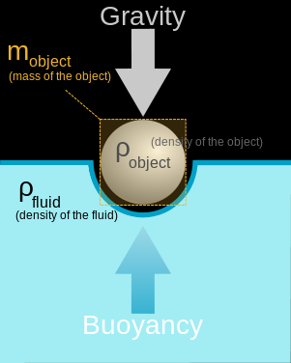
Image source: 2008 Yupi666, Wikimedia Commons http://commons.wikimedia.org/wiki/File:Buoyancy.svg
Notes:
Image source: 2008 Yupi666, Wikimedia Commons http://commons.wikimedia.org/wiki/File:Buoyancy.svg

Slide 7
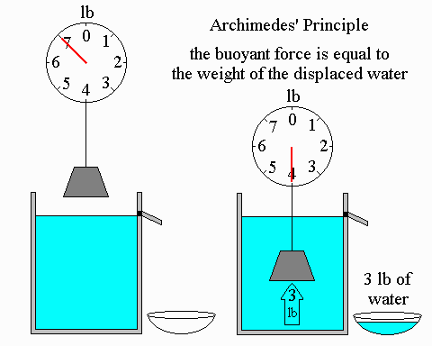
Archimedes’ Principle:
The buoyant force is equal to the weight of the displaced water.
Image source: Bradley W. Carroll. Used with permission. http://physics.weber.edu/carroll/archimedes/principle.htm
Notes:
Image source: Source: Dr. Bradley W. Carroll, Department of Physics, Weber State University, http://physics.weber.edu/carroll/archimedes/principle.htm
Emailed correspondence for permission to use image (bcarroll@weber.edu)

Slide 8
ball: Displaced water weighs less than the ball
hull: Displaced water weight equals hull weight
Image source: Bradley W. Carroll. Used with permission. http://physics.weber.edu/carroll/archimedes/principle.htm
Notes:
Image source: Dr. Bradley W. Carroll, Department of Physics, Weber State University http://physics.weber.edu/carroll/archimedes/principle.htm
Author received permission to use image via email correspondence (bcarroll@weber.edu)

Slide 9
Buoyant Force
Buoyant force is also equal to the difference between the weight of an object in air and weight of an object in fluid.
F_{B} = W_{air} - W_{fluid}
In other words, the apparent loss in weight of a body immersed in a fluid is equal to the weight of the displaced fluid.

Slide 10
Image source: Bill Winfield. Used with permission.
Notes:
Author received written permission from Bill Winfield (winfieldchem@msn.com) to use this image.
Author originally found this image online, and when emailed Bill requesting permission to use these images, he sent me PowerPoints that he used in his classes. He said he did not authorize this media to be placed on the Internet so author did not formally cite the “angelfire” website because it is not his.
http://www.angelfire.com/nc3/pweb/lessons/archimed.htm#Table%20of%20Contents

Slide 11
Other Relationships
Net force, F_{net} is the object’s apparent weight:
F_{net} = F_{B} – F_{g}(object)
F_{net} = (ρ_{f}V_{f}- ρ_{o}V_{o}) g
where: m=ρV
In solving buoyancy problems, the following derived expression is used:
F_{g}(object) = ρ_{o}
F_{B} ρ_{f}

Slide 12
Pascal’s Law

Slide 13
Pressure
Pressure is a measure of how much force is applied over a given area.
P = F
A
units:
1 Pa (Pascal) = 1 N/m²
1 atm = 10⁵ Pa

Slide 14
Pascal’s Law
“Pressure applied to a fluid in a closed container is transmitted equally to every point of the fluid and to the walls of the container.”

Slide 15
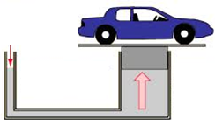
Pressure applied anywhere to a fluid causes a force to be transmitted equally in all directions.
Change in pressure disperses equally throughout the fluid.
Force acts at right angles to any surface in contact with the fluid.
A₂ = 10 m²
P₂ = ____?
F₂ = ____?
A₁ = 1 m²
F₁ = 10 N
P₁ = ___?
Image source: Bill Winfield. Used with permission.
Notes:
Image used with written permission from Bill Winfield (winfieldchem@msn.com).
I originally found this image online, and when I emailed Bill requesting permission to use these images, he sent me PowerPoints that he used in his classes. He said he did not authorize this media to be placed on the Internet so I will not formally cite the “angelfire” website because it is not his.
http://www.angelfire.com/nc3/pweb/lessons/pascalp.htm
P1 exerted equally in all directions
P1 = P2
A1 < A2 so F1 < F2

Slide 16
Bernoulli’s Principle

Slide 17
Types of Fluid Flow
Laminar – When fluid particles move along the same smooth path. The path is called a streamline.
Turbulent – When fluid particles flow irregularly causing changes in velocity. They form eddy currents.

Slide 18
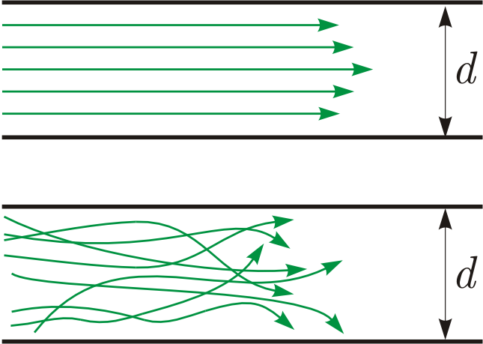
A
B
Source: Wikimedia Commons http://commons.wikimedia.org/wiki/File:Toky.png
Notes:
Which type of flow does each drawing represent? A is laminar flow; B is turbulent flow.
What are some real-world examples of each type of flow?
Image source: 2006 Dubaj, Wikimedia Commons http://commons.wikimedia.org/wiki/File:Toky.png

Slide 19
Bernoulli’s Principle
Continuity equation:
A₁v₁ = A₂v₂
Bernoulli’s principle:
“The pressure in a fluid decreases as the fluid’s velocity increases.”
Bernoulli’s equation:
P + ½ ρv² + ρgh = constant

Slide 20
Bernoulli’s equation at different points in a horizontal pipe:
P₁ + ½ρv₁² = P₂ + ½ρv₂²
Point 1
Point 2
Point 3
Image source: 2013 Emily Sappington, University of Houston
Notes:
Image source: 2013 Emily Sappington, University of Houston using Microsoft PowerPoint
Image is not perfect, but it should be interpreted as a horizontal pipe with no variation in height

Slide 21
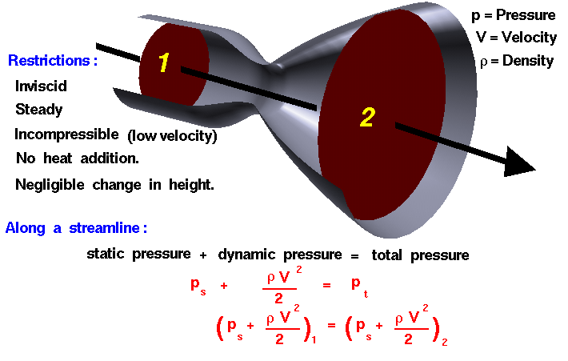
Bernoulli’s Equation
Source: NASA http://www.grc.nasa.gov/WWW/k-12/airplane/bern.html
Notes:
Image source: NASA http://www.grc.nasa.gov/WWW/k-12/airplane/bern.html

Slide 22
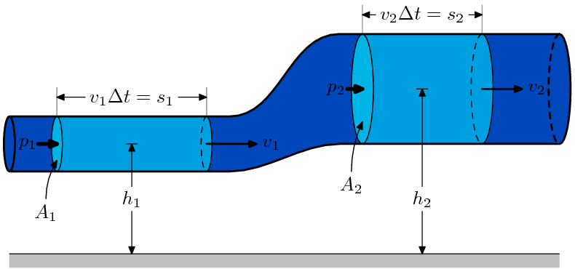
Bernoulli’s equation at two different points of varying height
P₁ + ½ρv₁² + ρgh₁ = P₂ + ½ρv₂² + ρgh₂
Source: http://commons.wikimedia.org/wiki/File:BernoullisLawDerivationDiagram.svg
Notes:
Image source: 2007 MannyMax, Wikimedia Commons http://commons.wikimedia.org/wiki/File:BernoullisLawDerivationDiagram.svg

