Slide 1
TIME LAPSE EMBRYO MONITORING WHAT IS ITS VALUE ?
ANASTASIOS ARGYRIOU
BIOLOGIST OF REPRODUCTION MSc, PhD
SENIOR CLINICAL EMBRYOLOGIST

Slide 2
INTRODUCTION
Fundamental parameters for achieving:
a successful on going pregnancy
the birth of a healthy baby,
during the course of IVF for infertility treatment, are:
a receptive endometrium
+
a genetically and metabolically normal embryo
+
an appropriate synchronization of their communication

Slide 3
INTRODUCTION
Critical steps limiting success rates in the laboratory phase:
embryo culture
proper evaluation of the available embryos
But, although there are evident correlations, embryo morphology is not always a robust and absolute indicator for implantation potential, since:
the best looking blastocyst fails to produce a pregnancy, or
a morphologically suboptimal embryo can develop into a healthy baby
Finally, only 35% of all cycles result in a pregnancy (Calhaz-Jorge et al., 2016)

Slide 4
INTRODUCTION
Morhological evaluation of the embryos at specific time points has been the method of choice for embryo selection for decades (Cummins et al., 1986, Edwards et al., 1981).
Morphological evaluation started with the strategy of measuring single features, such as:
pronuclear size and alignment (Sadowy et al., 1998)
multinucleation in early cleavage stages (Alikani et al., 2000)
blastomere fragmentation (Alikani et al., 1999)
blastocyst morphology (Gardner et al., 2000)
timing of cleavages (Johnson, 2002)
Mid-eighties: embryos with early first and second cleavages had implantation rates well above 30%

Slide 5
WHAT IS TIME LAPSE PHOTOGRAPHY?
Invented around 1932, Walt Disney was first to use it
Time Lapse is where a camera takes a sequence of images of a subject with an interval of time between each image
A cinematography technique considered as stop motion animation, involving a standard movie camera
The interval time varies from a second to a day or more and it is opposite of high speed photography
Follow up each activity and identify the exact time spent on each activity

Slide 6
ANDANTAGES OF TIME LAPSE PHOTOGRAPHY
Gives us benefits of time and motion studies
Enables workers and supervisors of all level involved in problem solving process
Incorporates knowledge and experience in future jobs
Converts wasted work to contribute to more productive

Slide 7
THE SHORT HISTORY OF TIME LAPSE MINITORING
Payne (1997): preliminary observations on polar body extrusion and pronuclear formation in human oocytes using time lapse cinematography
Pribenszky (2010): pregnancy achieved by transfer of a single blastocyst selected by time lapse monitoring
Wong (2010): non-invasive imaging of human embryos before embryonic genome activation predicts development to blastocyst stage
Meseguer (2011): the use of morhokinetics as a predictor of embryo implantation

Slide 8
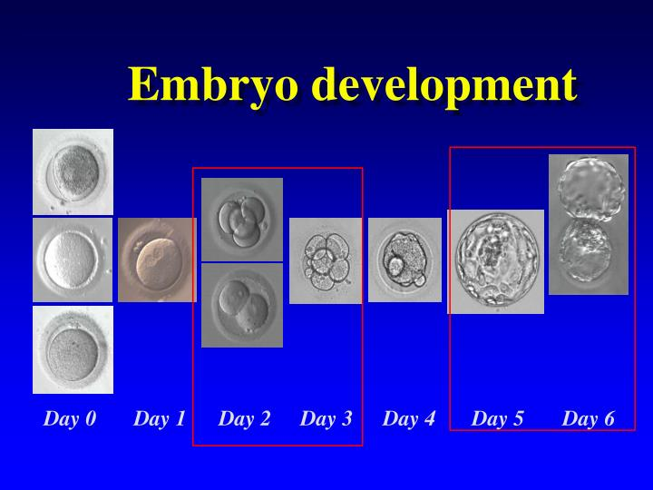
CULTURE AND EVALUATION OF THE EMBRYOS IN THE LABORATORY UNTIL TODAY
Embryo culture in sterile dishes, using suitable culture media in incubators, under controlled culture conditions (temperature, pH, gaz mixture)
Evaluation of the embryo development outside of the incubator and observation of morphological parameters under an inverted microscope

Slide 9
BUT, PROBLEMS…
The removal of the embryos from the incubator causes:
Disturbance of culture conditions
Stress of the embryos
Focused evaluation on the embryo morphology and the stage of embryo development
Dispersed observations on the embryos: loss of numerous information concerning their development

Slide 10
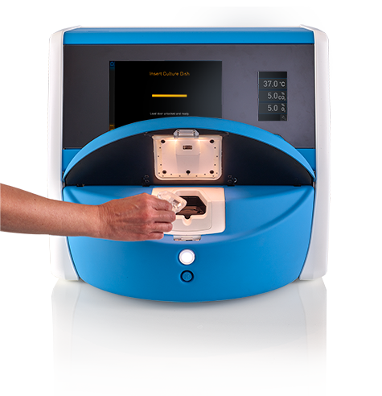
TIME LAPSE MONITORING SYSTEM IN A IVF LABORATORY
Continuous viewing on embryo development
Embryo monitored from inside a specific incubator equipped with a photography system
Creates archives used to select embryo(s) for embryo transfer

Slide 11
TIME LAPSE MONITORING SYSTEMS
Primo Vision (Bright field, embryo culture in multi-well dishes)
Embryoscope (Bright field, self contained incubation up to 12 cultured embryos)
Eeva (Dark field, automatic embryo prediction software, accurate observations of the blastomere membranes, less information for intracellular morphology and low ability to follow embryos with increasing number of cells)
All systems incorporate a digital inverted microscope that takes a picture of the embryos at 5-20 min. intervals.
The images are processed by custom image acquisition and then, displayed on a computer screen.
The pictures taken at preset intervals are then connected into short films that can be fast forwarded for detailed analysis.

Slide 12
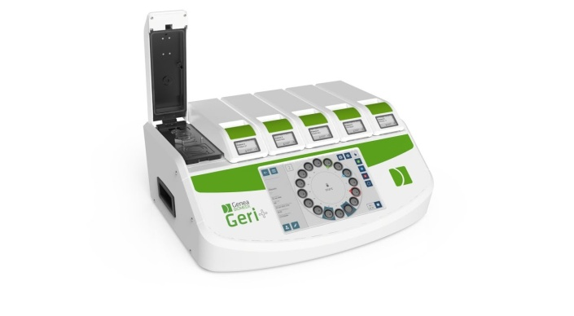
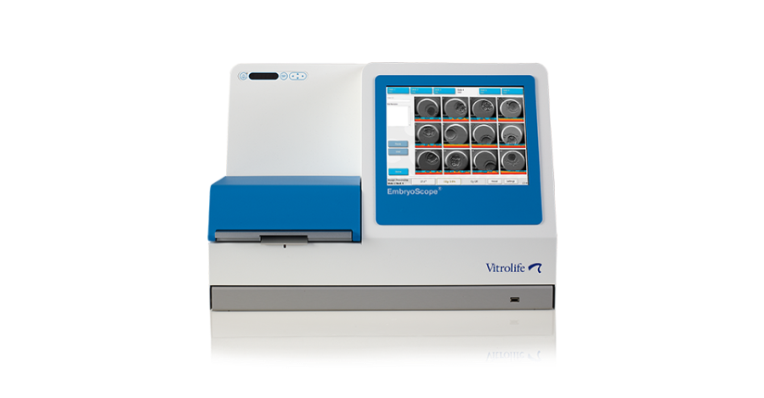
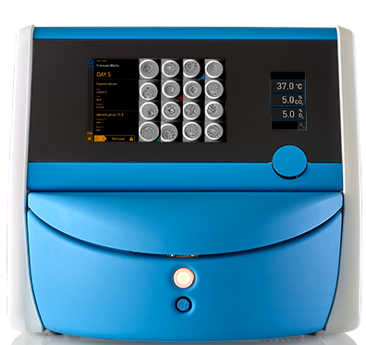
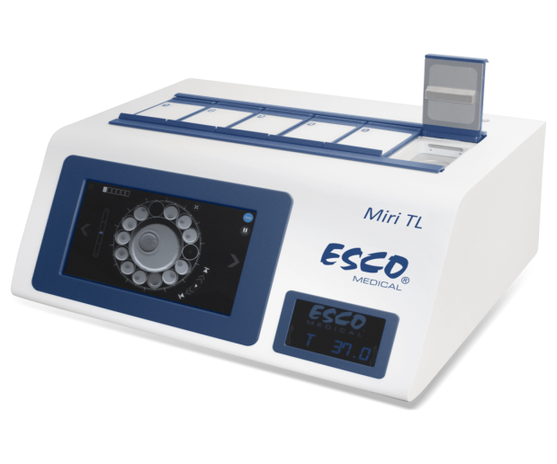
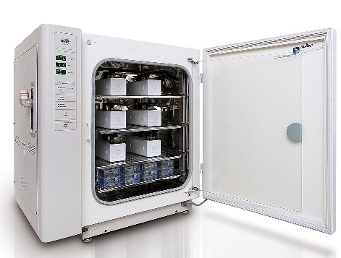
DIFFERENT TYPES OF TIME LAPSE MONITORING SYSTEMS

Slide 14
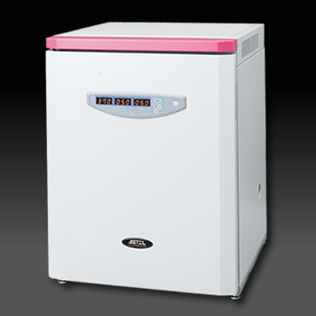
ADVANTAGES OF A TIME LAPSE MONITORING SYSTEM
Contributes to the maintenance of stable culture conditions and a better evaluation of the development of the embryos, no removal from the incubator (uninterrupted culture)
Offers very important information concerning the development, the mitotic divisions and the morphokinetic parameters of the embryos

Slide 15
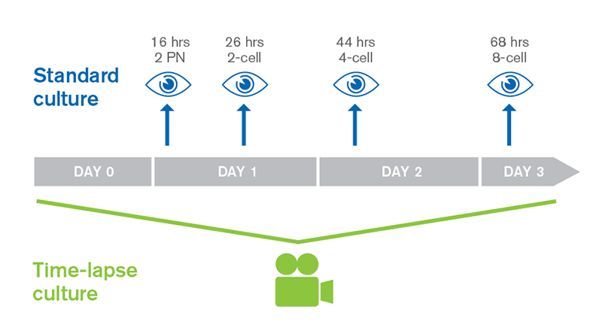
COMPARISON BETWEEN THE CONVENTIONAL OBSERVATION AND THE TIME LAPSE MONITORING SYSTEM

Slide 16
INDICATIONS FOR TIME LAPSE MONITORING SYSTEM
Older patients with high number of oocytes
Previous unsuccessful IVF patients
Previous successful patients (for single Embryo Transfer )
Good prognosis patients ( day 2/3, not blastocyst ET )
Benefits:
Confidence of transferring fewer embryos
Satisfied patients with greater information given

Slide 18
TIME LAPSE MONITORING SYSTEM means USE OF MORHOKINETICS for a better choice of an embryotransfer

Slide 19
“KINETICS” IN A CELL CYCLE

Slide 20
MORPHOKINETICS
Definition:
an analysis of the dynamics of cleavage divisions and processes such as compaction and cavitation
a link between the cellular divisions and the well precisely predetermined time of space that they occur during the embryonic development
they have provided both embryologists and clinicians with a new set of data embryonic behaviour during preimplantation development and its association with embryo quality
correlation with:
- the implantation capacity of the embryos
- the pregnancy rate
- the abortion rate

Slide 21
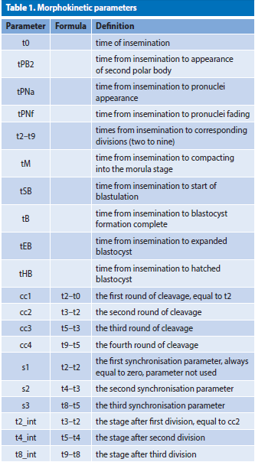
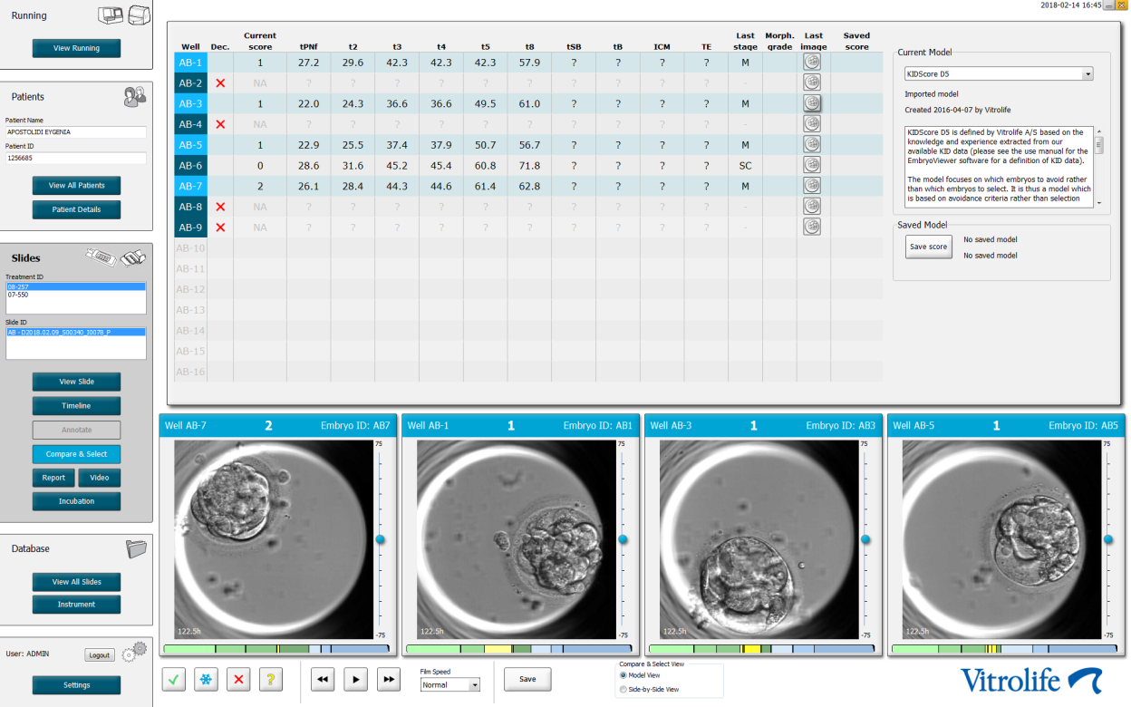
MORPHOKINETIC PARAMETERS AND EMBRYONIC DEVELOPMENT

Slide 22
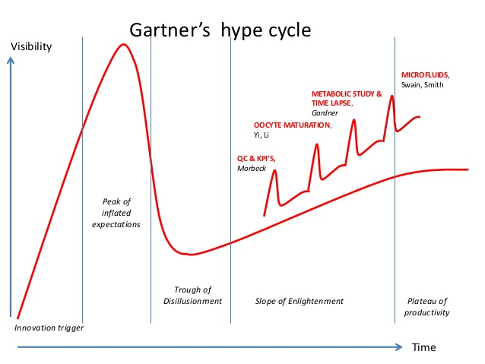
GARTNER’S HYPE CYCLE AND TIME LAPSE MONITORING SYSTEM
Starting point: moment of technological innovation
Expectations rise rapidly leading to a peak in visibility
Followed by a negative hype period where the technology does not live up to expectations
The technology matures and its potential is better understood
The technology reaches the plateau of productivity

Slide 23
BASIC RESEARCH DISCOVERY OF TIME LAPSE MARKERS
Cell division time-intervals (“P1, P2, P3”) predict successful development to the blastocyst stage:
Distinct timing window (Wong et al. Nature Biotechnology, 2010)
Reflect underlying molecular health (Wong et al. Nature Biotechnology, 2010)
Later correlated to implantation and blastocyst quality (Meseguer et al. Human Reprod.,2011; Hashimoto et al. Fertility & Sterility, 2012; Cruz et al. RBH Online, 2012)
Most recently examined for aneuploidy (Chavez et al. Nature Communications, 2012)

Slide 24
Non-invasive imaging of human embryos before embryonic genome activation predicts development to the blastocyst stage. ( Wong et al. , 2010.)
100 out of 242 thawed human zygotes imaged until blastocyst formation (day 5,6).
Events predicting blastocyst formation:
1. duration of first cytokinesis (14.3+6 min.)
2. time between 1st and 2nd mitosis (11.1+2.2 h)
3. time between 2nd and 3rd mitosis (1.0+1.6 h)
Conclusion:
Events predicting blastocyst formation occur prior to embryonic
genome activation.

Slide 25
The use of morphokinetics as a predictor of embryo implantation. (Meseguer et al., 2011.)
Findings:
Events significantly correlated with implantation:
1. time of division to 5 cells post ICSI (48.8 - 56.6 h)
2. time between division to 2 cells and 3 cells (< 11.9 h)
3. time between division to 3 cells and 4 cells (< 0.76 h)
Events largely precluding implantation:
1. multinucleation at 4 cell stage
2. uneven blastomere size at 2 cell stage
3. abrupt cell division to 3 or more cells.

Slide 26
Morphokinetics: Predicting development to blastocyst, expansion and implantation ( Dal Canto et al., 2012)
Embryos reaching the blastocyst stage without blastocoel expansion on day 5 associated with progressive cleavage delay
Implantation:
- YES 8 cell at 54.9 ±2 h
- NO 8 cell at 58.0 ±7 h, p=0.035
Conclusion: Conventional static observations on day 2 (42-44 h) and day 3 (66-68 h) are inappropriate for accurate evaluation

Slide 27
MORPHOKINETICS IN BIBLIOGRAPHY

Slide 28
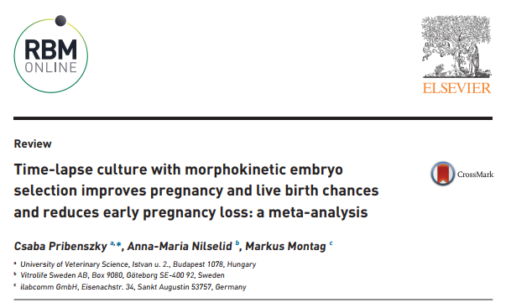
KID Score (Known Implantation Data)
Auxiliary tool designed in order to help embryologists to make decisions about the embryo selection for embryotransfer, cryopreservation or rejection
The creation of the algorithm KID score is based on this study, by analyzing retrospectively the mophokinetic parameters of a great number of embryos in IVF cycles with sET.

Slide 29
TIME LAPSE AND PREIMPLANTATION GENETIC TESTING FOR ANEUPLOIDIES (PGT)
Follow-up of the embryonic development and selection of the best time for the embryo biopsy
Correlation between the embryo quality and the result of the biopsy: selection of genetically normal embryos with the best morphokinetic parameters

Slide 30
TIME – LAPSE WINDOW CORRELATED TO ANEUPLOIDY
“Based on the current data set, it appears that morphokinetic data do not have the precision to replace molecular techniques used in PGS for identifying euploid embryos.
This is evidenced by the significant overlap in kinetics between euploid and aneuploid embryos and the only moderate predictive ability of our own as well as other existing models.”

Slide 31
TIME – LAPSE WINDOW CORRELATED TO ANEUPLOIDY
“It is worth noting that despite the correlation between some kinetic markers and embryo ploidy status, TLM cannot be used as a substitute for PGT-A to accurately select euploid embryos.”

Slide 32
TIME – LAPSE WINDOW CORRELATED TO ANEUPLOIDY
“Despite their poor ability to discriminate ploidy, morphokinetics may be useful as and adjunct to PGS in selecting those PGS-screened euploid embryos with the best chances of implantation and live birth; however, further study is needed. “

Slide 33
TIME – LAPSE WINDOW CORRELATED TO ANEUPLOIDY

Slide 34
TODAY…..
Different studies have created algorithms that allow for effective embryo assessment

Slide 35
HOW TO PREDICT THE ABILITY TO ACHIEVE A BLASTOCYST STAGE? (Cruz et al, 2012; Motato et al, 2016; Yang et al, 2015)

Slide 36
Going further… HOW TO PREDICT WHICH EMBRYO WILL SUCCESSFULLY IMPLANT? (Meseguer et al, 2011; Liu et al, 2016; Motato et al, 2016)

Slide 37
Going deeper… HOW TO PREDICT PLOIDY OF DEVELOPING EMBRYOS? (Basile et al, 2014; Del Carmen Nogales, 2016; Campbell et al, 2013a)

Slide 38
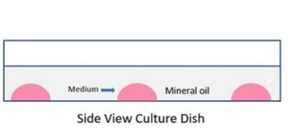
TIME LAPSE MONITORING SYSTEM AND QUALITY CONTROL
Ultimate goal of an IVF program: a high live birth rate of healthy singletons
Success: depends, in part, on a culture system that supports the development of healthy embryos
Optimal culture conditions: the product of a good quality control system,
(stable environment, detection of prematurely embryo-toxic conditions)
Time Lapse System: test and compare new culture media
% of survival: thawed and PGT tested embryos
Internal Quality Control among Clinical Embryologists
VOC’s

Slide 39
TIME LAPSE MONITORING SYSTEM An effective tool for the Embryology laboratory
% of fertilization,
% of blastocyst development
% of pregnancy
% of abortion
Temperature,
CO₂ , VOC,
Presence of particles
Morphokinetic parameters

Slide 40
CONCLUSIONS
In-vitro culture of embryos and the in-process decision-making of whether to transfer, cryopreserve or discard embryos, is the most crucial and challenging task in Human Assisted Reproduction. Although the first time-lapse analysis of the developing mammalian embryo was published in 1929 (Lewis and Gregory, 1929), a further 80 years passed until the first routine clinical use of time-lapse in the human IVF laboratory (Meseguer et al., 2011)
Time-lapse analysis, coupled with morphology, significantly improved implantation and clinical pregnancy in multi-center trials using algorithms.
Time-lapse analysis provides a unique opportunity to de-select embryos
that show abnormalities of cleavage, syngamy and/or cytokinesis
compared to static evaluation.

Slide 41
CONCLUSIONS
Revolution on the way of evaluation of the embryo development:
- easily incorporated into the IVF laboratory
- single step culture media – uninterrupted culture
- potential to standardize embryo assessment
- morphokinetics / KID score
- exclude embryos with direct / abnormal cleavage, sub-optimal
development, gragmentation, multinucleation
- improved embryo selection may increase the pregnancy rate and
decrease the abortion rate
- low probability of mitotic mistakes leading to high mosaicism rate

Slide 42
CONCLUSIONS
Quality control tool for Embryology laboratory:
- control of good function of culture systems (media – incubators)
- control of any change and new equipment inside the laboratory
- timely detection of possible problems makes easier their
resolution
- the selection of embryos through time-lapse technology should
not be considered as a replacement for PGS. However, it does
represent an excellent selection tool for good prognosis patients
who are not indicated for PGS
Time Lapse and PGT
Better together

Slide 43
CHALLENGES AND PERSPECTIVES OF THE MORPHOKINETIC MODELS
The last decade has brought a great advancement in the embryo-safe time-lapse imaging technique and use of predictive algorithms based on morphokinetics
However, we are still at the beginning of our journey leading to the establishment of a universal, clinical morphokinetic algorithm for embryo selection. We have taken the first step: we have created algorithms that allow for effective embryo assessment in individual laboratories. Therefore we need to make another step forward and focus our efforts on creation of an algorithm that would be effective in different clinics and that would take into consideration differences in IVF procedures (hormonal stimulation procedures, fertilization methods, culture media, etc.).
Additionally, in order to maximize the predictive power of the reproductive outcome models, we should be continuing an intensive search for new biomarkers of embryonic quality. We should explore the possibility of combining time-lapse information with data provided by other diagnostic methods, such as genetic diagnostics, transcriptomics, proteomics or metabolomics (Yang et al. 2014, Dominguez et al. 2015, Tejera et al. 2016).

Slide 44
“ The journey is the most important and not the destination “ ( “ ITHAKI” , K. Kavafis )

